Slide 1

Design and Implementation of a 64-bit RISC-V IMAC Architecture with Privilege Modes and Level-1 Caches
Final Presentation

Slide 2



Presenters
Name | ID
Ahmed Hamdi Ibrahim | 19015219
Basmala El-Dabaa Fayez | 19015517
Ziad Taha Mohamed Taha | 19015723
Mohamed Maged Abdulhalim | 19016475
Mohamed Morsi Abd-Elsamee | 19016505
Mohamed Mohamed Tariq | 19017130
Ali Khaled Mohamed | 19017540
Aly Mohamed El-Ruby | 19016023
Nsreen Nashaat Abdo | 18011992
Hythem Ahmed Shaban | 19016856

Slide 3
Outline
Introduction
Design
Base I ISA
C-extension
M-extension
A-extension
Caches
Branch Prediction
Privileged ISA
Verification
FPGA
ASIC

Slide 4
Chapter 1 Introduction

Slide 5
Introduction
Motivation:
- Chose a 64-bit RISC-V IMAC core with privilege modes and level 1 caches to run OS such as LINUX and assembly programs.
- It aims to expand into automotive, aerospace, and telecommunications markets, standardize extensions, and improve compatibility.
- Being open-source provides programmers maximum hardware access and software flexibility.
- A 64-bit architecture supports modern software applications, operating systems,
and databases, with enhanced security features like larger cryptographic keys.

Slide 6
Introduction
History:
1. Developed at UC Berkeley's Parallel Computing Lab
from 2010.
2. Open-source instruction set architecture (ISA) known for
simplicity and modularity.
3. Widely adopted across diverse applications from IoT to
high-performance computing for its customizable and
scalable design.

Slide 7
Introduction
What is RISC-V
1.Open Source
2.Simplicity and Flexibility
3.Modular Design
4.Scalability
5.Community-Driven
6.Adoption

Slide 8
Introduction
Objectives:
1. Design a RISC-V Core Processor.
2. Incorporate Cached Memory.
3. Support for Privileged Modes.
4. Verification and Testing.
5. Documentation and Analysis.

Slide 9
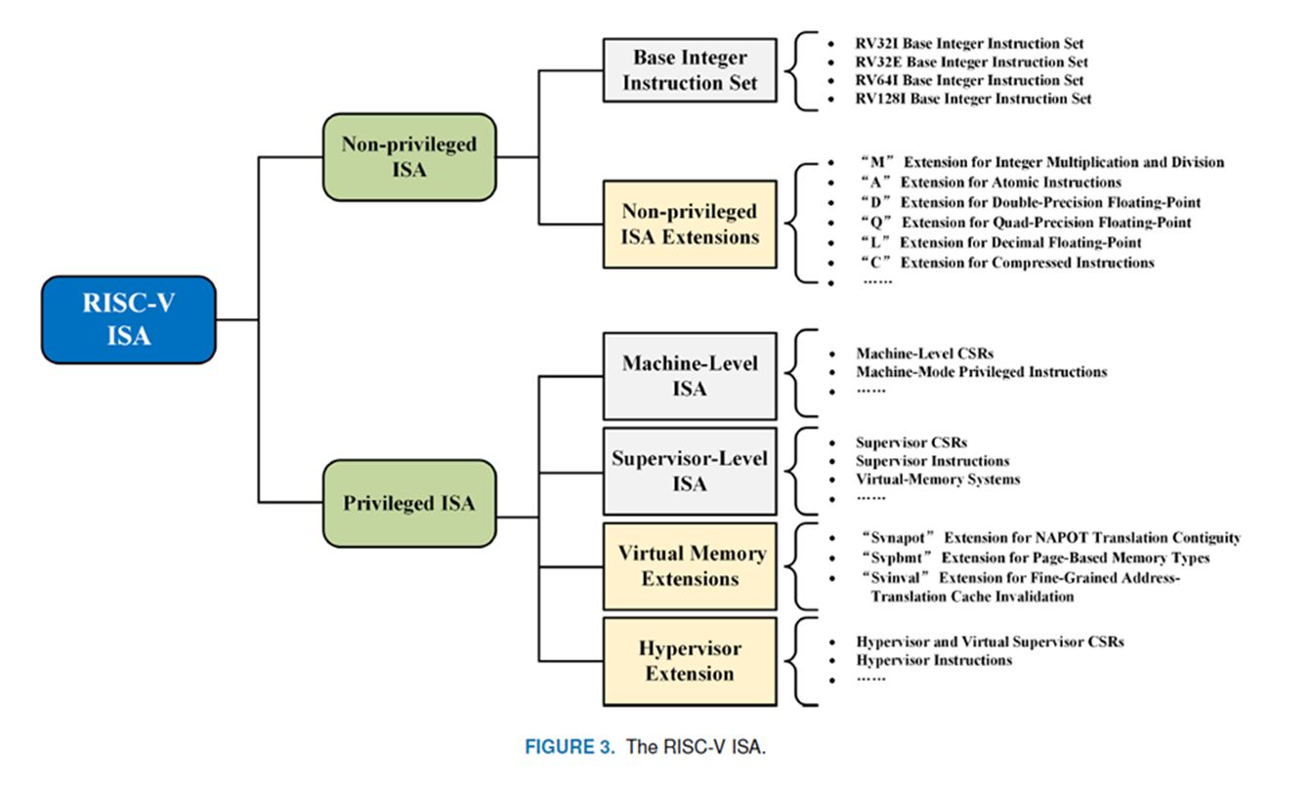
Introduction
RISV-V Extensions:

Slide 10
Introduction
PRIVILEGED MODES:
M – Machine
U – User
S – Supervisor

Slide 11
Introduction
NON-PRIVILEGED ISA EXTENSIONS:
1)I: Extension for general-purpose computing.
2)M: Extension for integer multiplication and division.
3)A: Extension for atomic instructions.
4)C: Extension for compressed instructions.

Slide 12
Introduction
Why do we need a privileged architecture?
1-We need to manage shared resources
-Memory
-I/O devices
-Cores
2-we need to protect shared resources
3-we need to insulate implementation details
4-to run OS on RISC-V core

Slide 13
Introduction
Comparison between RISC-V ,ARM and x86
RISC-V: Open source, Use reduced instruction set so
the decoders are simpler.
ARM and x86:widely used, they come with licensing
fees and restrictions, Use complex instruction set so
the decoders are more complex.

Slide 14
Chapter 2 Implementation of Base-I ISA

Slide 15
Base-I | RV64I ISA
R-Type
add(w), sub(w), xor, or, and, sll(w), srl(w), sra(w), slt, sltu
I-Type
addi(w), xori, ori, andi, slli(w), srli(w), srai(w), slti, sltiu
lb(u), lh(u), lw(u), ld
jalr
S-Type
sb, sh, sw, sd
B-Type
beq, bne, blt(u), bge(u)
J-Type
jal
U-Type
lui, auipc

Slide 16
Base-I | RV64I Microarchitecture
Subset of Base-I from Harris & Harris Book

Slide 17
Base-I | RV64I Microarchitecture
Design Methodology:
Start by designing Single Cycle Datapath
Add Control Unit
Pipeline the Single Cycle
Add Hazard Unit

Slide 18
Base-I | RV64I Microarchitecture
Design Methodology:
Start by designing Single Cycle Datapath
Datapath: start with lw instruction
Example: lw rd, imm(rs1)
I-Type
31:20 | 19:15 | 14:12 | 11:7 | 6:0
imm | rs1 | funct3 | rd | Op
12 bits | 5 bits | 3 bits | 5 bits | 7 bits

Slide 19
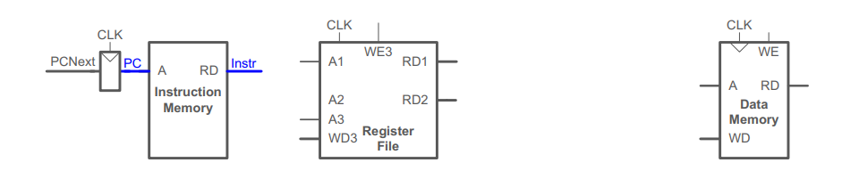
Base-I | RV64I Microarchitecture
Design Methodology:
Start by designing Single Cycle Datapath
Datapath: start with lw instruction
Example: lw rd, imm(rs1)
lw fetch

Slide 20
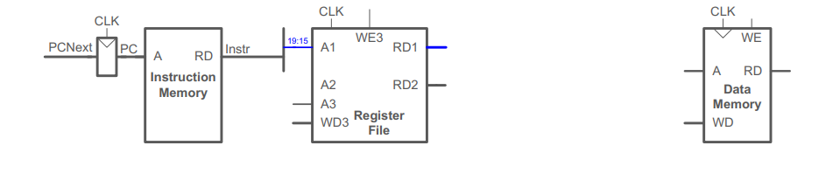
Base-I | RV64I Microarchitecture
Design Methodology:
Start by designing Single Cycle Datapath
Datapath: start with lw instruction
Example: lw rd, imm(rs1)
lw Reg Read

Slide 21
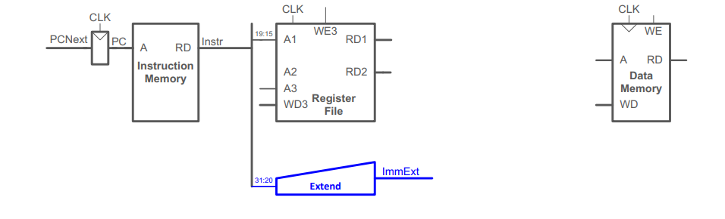
Base-I | RV64I Microarchitecture
Design Methodology:
Start by designing Single Cycle Datapath
Datapath: start with lw instruction
Example: lw rd, imm(rs1)
lw Immediate

Slide 22
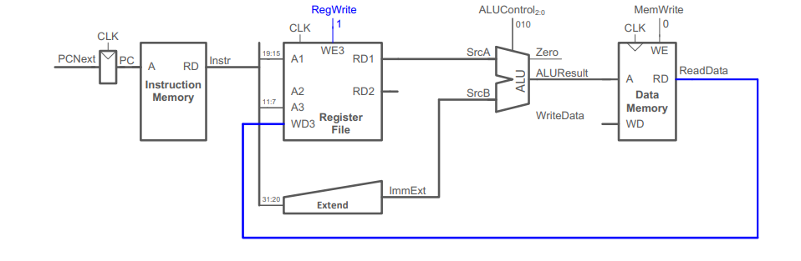
Base-I | RV64I Microarchitecture
Design Methodology:
Start by designing Single Cycle Datapath
Datapath: start with lw instruction
Example: lw rd, imm(rs1)
lw Mem Read

Slide 23
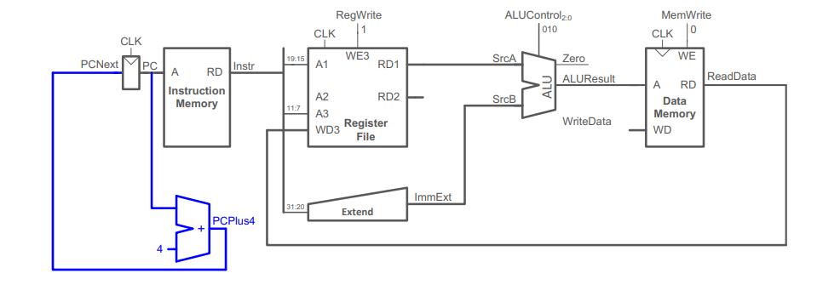
Base-I | RV64I Microarchitecture
Design Methodology:
Start by designing Single Cycle Datapath
Datapath: start with lw instruction
Example: lw rd, imm(rs1)
PC Increment

Slide 24
Base-I | RV64I Microarchitecture
Design Methodology:
Start by designing Single Cycle Datapath

Slide 25
Base-I | RV64I Microarchitecture
Design Methodology:
Add Control Unit
op | Instruct | RegWrite | ImmSrc | ALUSrc | MemWrite | ResultSrc | Branch | ALUOp | PCUpdate | ALUControl
3 | lw | 1 | 00 | 1 | 0 | 10 | 0 | 00 | 0 | 000
35 | sw | 0 | 01 | 1 | 1 | XX | 0 | 00 | 0 | 000
51 | R-type | 1 | XX | 0 | 0 | 01 | 0 | 10 | 0 | and | 010
 |  |  |  |  |  |  |  |  |  | or | 011
 |  |  |  |  |  |  |  |  |  | add | 000
 |  |  |  |  |  |  |  |  |  | sub | 001
 |  |  |  |  |  |  |  |  |  | slt | 101
99 | beq | 0 | 10 | 0 | 0 | XX | 1 | 01 | 0 | 001
19 | addi | 1 | 00 | 1 | 0 | 01 | 0 | 10 | 0 | 000
111 | jal | 1 | 11 | X | 0 | 00 | 0 | XX | 1 | XXX

Slide 26
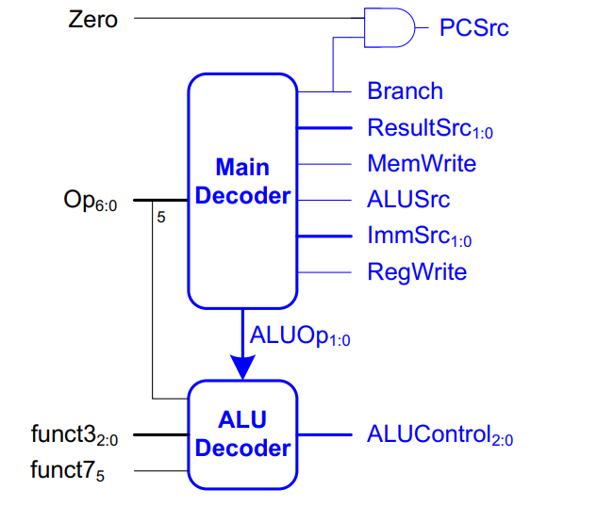
Base-I | RV64I Microarchitecture
Design Methodology:
Add Control Unit

Slide 27
Base-I | RV64I Microarchitecture
Design Methodology:
Add Control Unit

Slide 28
Base-I | RV64I Microarchitecture
Design Methodology:
Pipeline the Single Cycle
Add pipelines.

Slide 29
Base-I | RV64I Microarchitecture
Design Methodology:
Pipeline the Single Cycle
Correct Pipelined Datapath. (Rd must arrive at same time as Result)

Slide 30
Base-I | RV64I Microarchitecture
Design Methodology:
Pipeline the Single Cycle
Add Control Unit. (control signals travel with their instructions)

Slide 31
Base-I | RV64I Microarchitecture
Design Methodology:
Add Hazard Unit

Slide 32
Base-I | RV64I Microarchitecture
Missed Instructions?!
Subset of Base-I from Harris & Harris Book

Slide 33
Base-I | RV64I Microarchitecture
Instruction | Format | Opcode | Funct3 | Funct7 | Description
lb | I | 0000011 | 0x0 |  | rd = M[rs1+imm][7:0]
lh | I | 0000011 | 0x1 |  | rd = M[rs1+imm][15:0]
lbu | I | 0000011 | 0x4 |  | rd = M[rs1+imm][7:0]
lhu | I | 0000011 | 0x5 |  | rd = M[rs1+imm][15:0]
sb | S | 0100011 | 0x0 |  | M[rs1+imm][7:0] = rs2[7:0]
sh | S | 0100011 | 0x1 |  | M[rs1+imm][15:0] = rs2[15:0]
bne | B | 1100011 | 0x1 |  | if(rs1 != rs2) PC += imm
blt | B | 1100011 | 0x4 |  | if(rs1 < rs2) PC += imm
bge | B | 1100011 | 0x5 |  | if(rs1 >= rs2) PC += imm
bltu | B | 1100011 | 0x6 |  | if(rs1 < rs2) PC += imm
bgeu | B | 1100011 | 0x7 |  | if(rs1 >= rs2) PC += imm
jalr | I | 1100111 | 0x0 |  | rd = PC+4; PC = rs1 + imm
lui | U | 0110111 |  |  | rd = imm << 12
auipc | U | 0010111 |  |  | rd = PC + (imm << 12)
Subset of Base-I from Harris & Harris Book

Slide 34
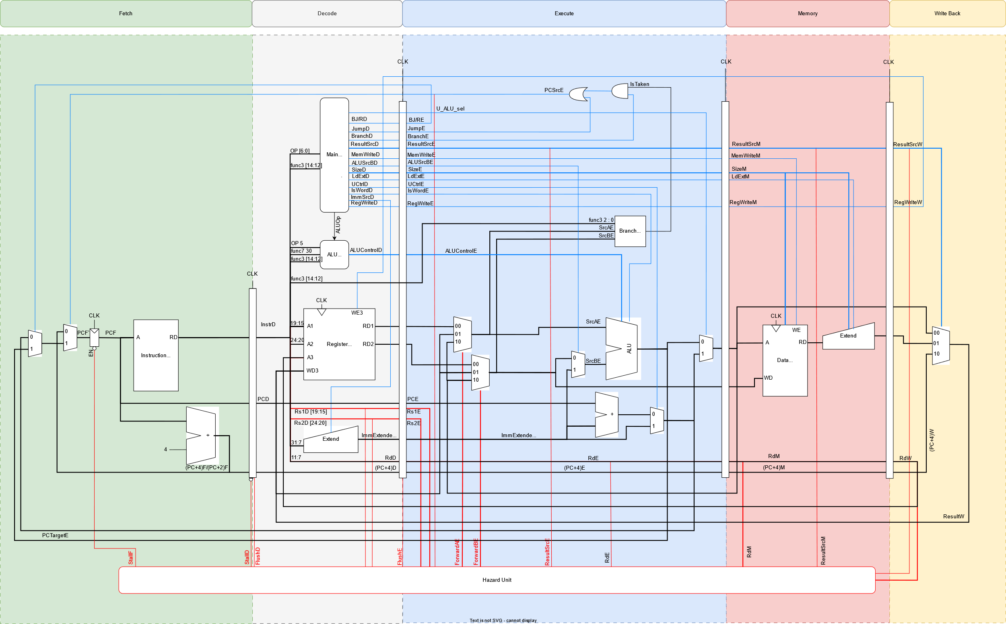
Base-I | RV64I Microarchitecture
JALR
rd = PC + 4
PC += imm

Slide 35
Base-I | RV64I Microarchitecture
LUI
rd = imm << 12

Slide 36
Base-I | RV64I Microarchitecture
AUIPC
rd = PC + (imm << 12)

Slide 37
Base-I | RV64I Microarchitecture
Instruction | Format | Opcode | Funct3 | Funct7 | Description
lb | I | 0000011 | 0x0 |  | rd = M[rs1+imm][7:0]
lh | I | 0000011 | 0x1 |  | rd = M[rs1+imm][15:0]
lbu | I | 0000011 | 0x4 |  | rd = M[rs1+imm][7:0]
lhu | I | 0000011 | 0x5 |  | rd = M[rs1+imm][15:0]
sb | S | 0100011 | 0x0 |  | M[rs1+imm][7:0] = rs2[7:0]
sh | S | 0100011 | 0x1 |  | M[rs1+imm][15:0] = rs2[15:0]
bne | B | 1100011 | 0x1 |  | if(rs1 != rs2) PC += imm
blt | B | 1100011 | 0x4 |  | if(rs1 < rs2) PC += imm
bge | B | 1100011 | 0x5 |  | if(rs1 >= rs2) PC += imm
bltu | B | 1100011 | 0x6 |  | if(rs1 < rs2) PC += imm
bgeu | B | 1100011 | 0x7 |  | if(rs1 >= rs2) PC += imm
jalr | I | 1100111 | 0x0 |  | rd = PC+4; PC = rs1 + imm
lui | U | 0110111 |  |  | rd = imm << 12
auipc | U | 0010111 |  |  | rd = PC + (imm << 12)

Slide 38
Base-I | RV64I Microarchitecture
lb(u), lh(u), sb, sh
Handled in Data memory & Load extend

Slide 39
Base-I | RV64I Microarchitecture
B-Type
Handled in Branch unit

Slide 40
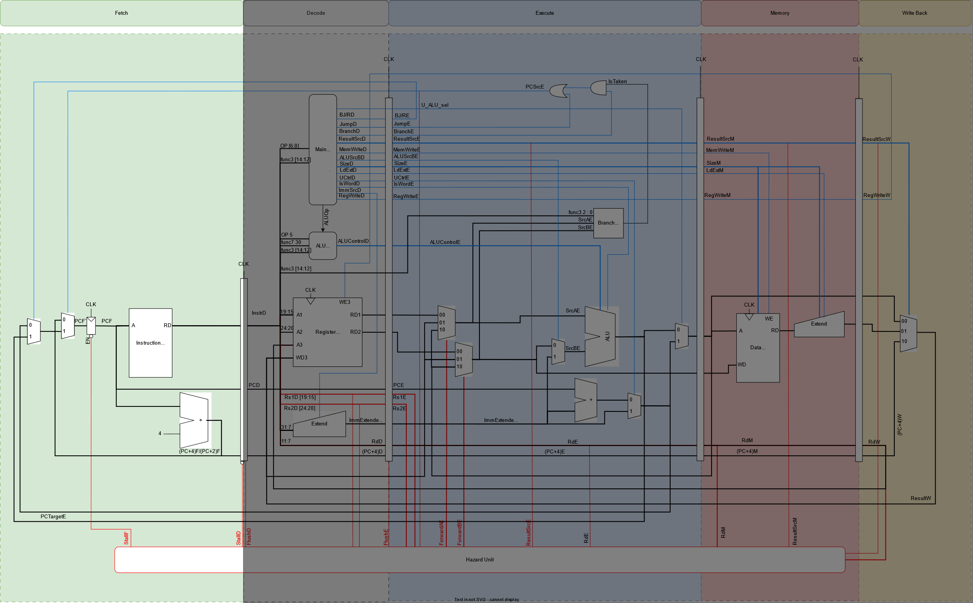
Base-I | RV64I Design: Fetch Stage

Slide 41
Base-I | RV64I Design: Fetch Stage
Instruction Memory
will be discussed in caches

Slide 42
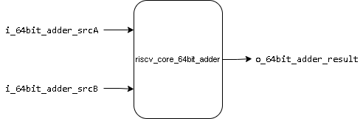
Base-I | RV64I Design: Fetch Stage
64-bit adder
It is used to increment PC
I/O | Width | Description
i_64bit_adder_srcA | 64 | Operand 1 (current PC)
i_64bit_adder_srcB | 64 | Operand 2 (64’h4)
o_64bit_adder_result | 64 | Adder result (PC+4)

Slide 43
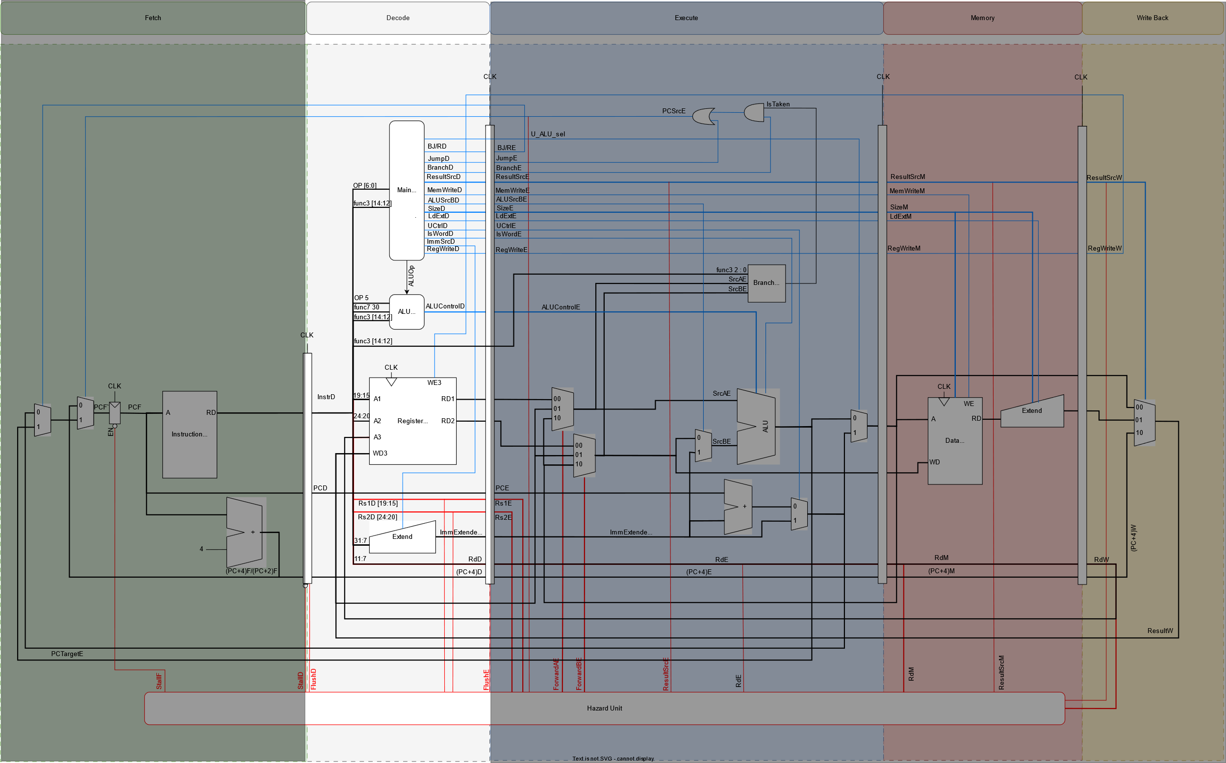
Base-I | RV64I Design: Decode Stage

Slide 44
Base-I | RV64I Design: Decode Stage
Main Decoder
o_imsrc
o_UCtrl
o_resultsrc
i_opcode
o_regwrite
o_alusrcB
o_memwrite
o_branch
i_funct3
riscv_core_main_decoder
o_jump
o_bjreg
o_size
o_LdExt
i_funct7
o_isword
o_aluop
o_imsel
o_new_mux_sel
o_read

Slide 45
Base-I | RV64I Design: Decode Stage
ALU Decoder
Port Name | Direction | Width | Description
i_funct3 | Input | 3 | funct3 bits of the instruction
i_aluop | Input | 1 | Enables the ALU decoder
i_funct7_5 | Input | 1 | Bit number 5 of funct7 part of the instruction
i_funct7_0 | Input | 1 | Bit number 0 of funct7 part of the instruction
i_opcode_5 | Input | 1 | Bit number 5 of opcode part of the instruction
o_alu_control | Output | 4 | Specifies the ALU operation
i_funct3
i_aluop
i_funct7_5
riscv_core_alu_decoder
o_alu_control
i_funct7_0
i_opcode_5

Slide 46
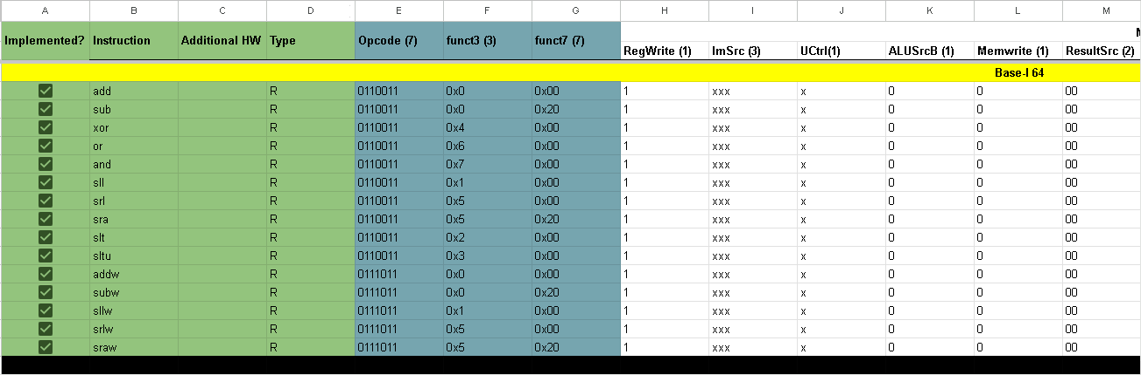
Base-I | RV64I Design: Decode Stage
Main Decoder and ALU Decoder
Link

Slide 47
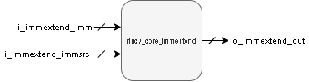
Base-I | RV64I Design: Decode Stage
Immediate Extend
I/O | Width | Description
i_immextend_imm | 25 | Instr[31:20]
 |  | Instr[31:25], Instr[11:7]
 |  | Instr[31:12]
i_immextend_immsrc | 3 | Type of extend according to instruction type
O_immextend_out | 64 | Extended output

Slide 48
Base-I | RV64I Design: Decode Stage
Immediate Extend
Format | i_immextend_immsrc | o_immextend_out
I | 3’b000 | {{52{instr[31]}},instr[31:20]}
S | 3’b001 | {{52{Instr[31]}}, Instr[31:25], Instr[11:7]}
B | 3’b010 | {{52{Instr[31]}}, Instr[7], Instr[30:25], Instr[11:8], 1’b0}
J | 3’b011 | {{44{Instr[31]}}, Instr[19:12], Instr[20], Instr[30:21], 1’b0}
R | 3’b100 | {32{instr[31]} ,instr[31:12], {12{1'b0}}}

Slide 49
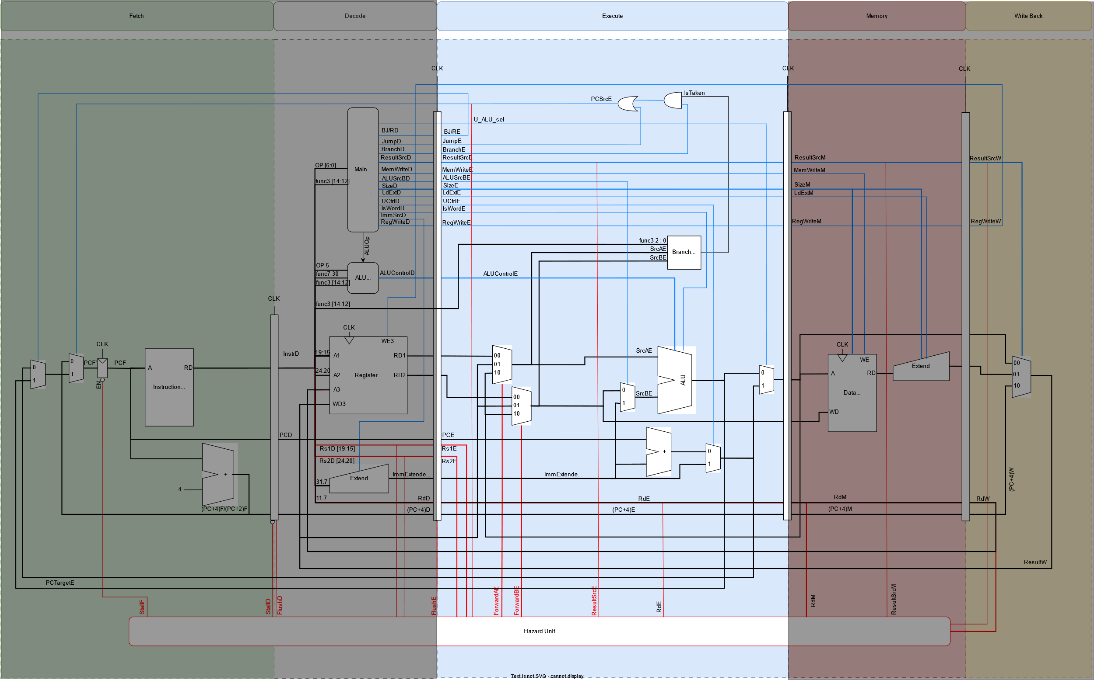
Base-I | RV64I Design: Execute Stage

Slide 50
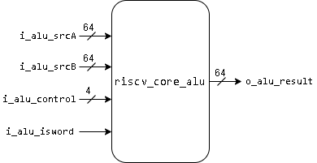
Base-I | RV64I Design: Execute Stage
ALU
I/O | Width | Description
i_alu_srcA | 64 | Operand 1
i_alu_srcB | 64 | Operand 2
i_alu_control | 4 | ALU operation
i_alu_isword | 1 | Specifies whether the instr is word or not
o_alu_result | 64 | ALU result

Slide 51
Base-I | RV64I Design: Execute Stage
ALU
i_alu_isword | i_alu_control | Operation
1’b0 | 4’b0000 | o_alu_result = i_alu_srcA + i_alu_srcB
1’b0 | 4’b0001 | o_alu_result = i_alu_srcA - i_alu_srcB
1’b0 | 4’b0110 | o_alu_result = i_alu_srcA ^ i_alu_srcB
1’b0 | 4’b0011 | o_alu_result = i_alu_srcA | i_alu_srcB
1’b0 | 4’b0010 | o_alu_result = i_alu_srcA & i_alu_srcB
1’b0 | 4’b0100 | o_alu_result = i_alu_srcA << i_alu_srcB[5:0]
1’b0 | 4’b0111 | o_alu_result = i_alu_srcA >> i_alu_srcB[5:0]
1’b0 | 4’b1111 | o_alu_result = i_alu_srcA >>> i_alu_srcB[5:0]
1’b0 | 4’b0101 | o_alu_result = i_alu_srcA < i_alu_srcB
1’b0 | 4’b1000 | o_alu_result = i_alu_srcA(U) < i_alu_srcB(U)
1’b1 | 4’b0000 | o_alu_result = i_alu_srcA[31:0] + i_alu_srcB[31:0] (sign ext)
1’b1 | 4’b0001 | o_alu_result = i_alu_srcA[31:0] - i_alu_srcB[31:0] (sign ext)
1’b1 | 4’b0100 | o_alu_result = i_alu_srcA[31:0] << i_alu_srcB[4:0] (sign ext)
1’b1 | 4’b0111 | o_alu_result = i_alu_srcA[31:0] >> i_alu_srcB[4:0] (sign ext)
1’b1 | 4’b1111 | o_alu_result = i_alu_srcA[31:0] >>> i_alu_srcB[4:0] (sign ext)

Slide 52
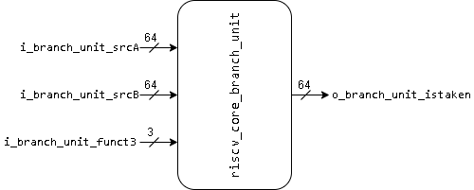
Base-I | RV64I Design: Execute Stage
Branch Unit
I/O | Width | Description
i_branch_unit_srcA | 64 | Operand 1
i_branch_unit_srcB | 64 | Operand 2
i_branch_unit_funct3 | 3 | Specifies branch instr
o_branch_unit_istaken | 1 | Flag raised if the condition is true

Slide 53
Base-I | RV64I Design: Execute Stage
Branch Unit
i_branch_unit_funct3 | Instr. | Operation
3’b000 | BEQ | istaken = i_branch_unit_srcA == i_branch_unit_srcB
3’b001 | BNE | istaken = i_branch_unit_srcA != i_branch_unit_srcB
3’b100 | BLT | istaken = i_branch_unit_srcA < i_branch_unit_srcB
3’b101 | BGE | istaken = i_branch_unit_srcA >= i_branch_unit_srcB
3’b110 | BLTU | istaken = i_branch_unit_srcA(U) < i_branch_unit_srcB(U)
3’b111 | BGEU | Istaken = i_branch_unit_srcA(U) >= i_branch_unit_srcB(U)

Slide 54
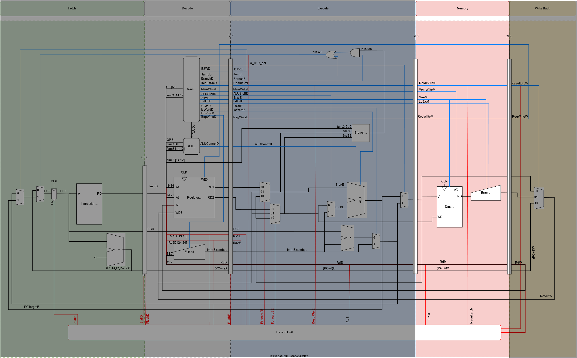
Base-I | RV64I Design: Memory Stage

Slide 55
Base-I | RV64I Design: Memory Stage
Data Memory
will be discussed in caches

Slide 56
Base-I | RV64I Design: Memory Stage
Load Extend
Port Name | Direction | Width | Description
i_su_extend | Input | 1 | Determines whether the instruction is signed or unsigned.
i_r_w_size | Input | 2 | Determines the size of the load instruction e.g., LD, LW, LH, LB.
i_rdata | Input | 64 | Data loaded from memory without extend.
o_rdata | Output | 64 | Data loaded from memory after sign/zero extend.
i_su_extend
i_r_w_size
riscv_core_ldextend
o_rdata
i_rdata

Slide 57
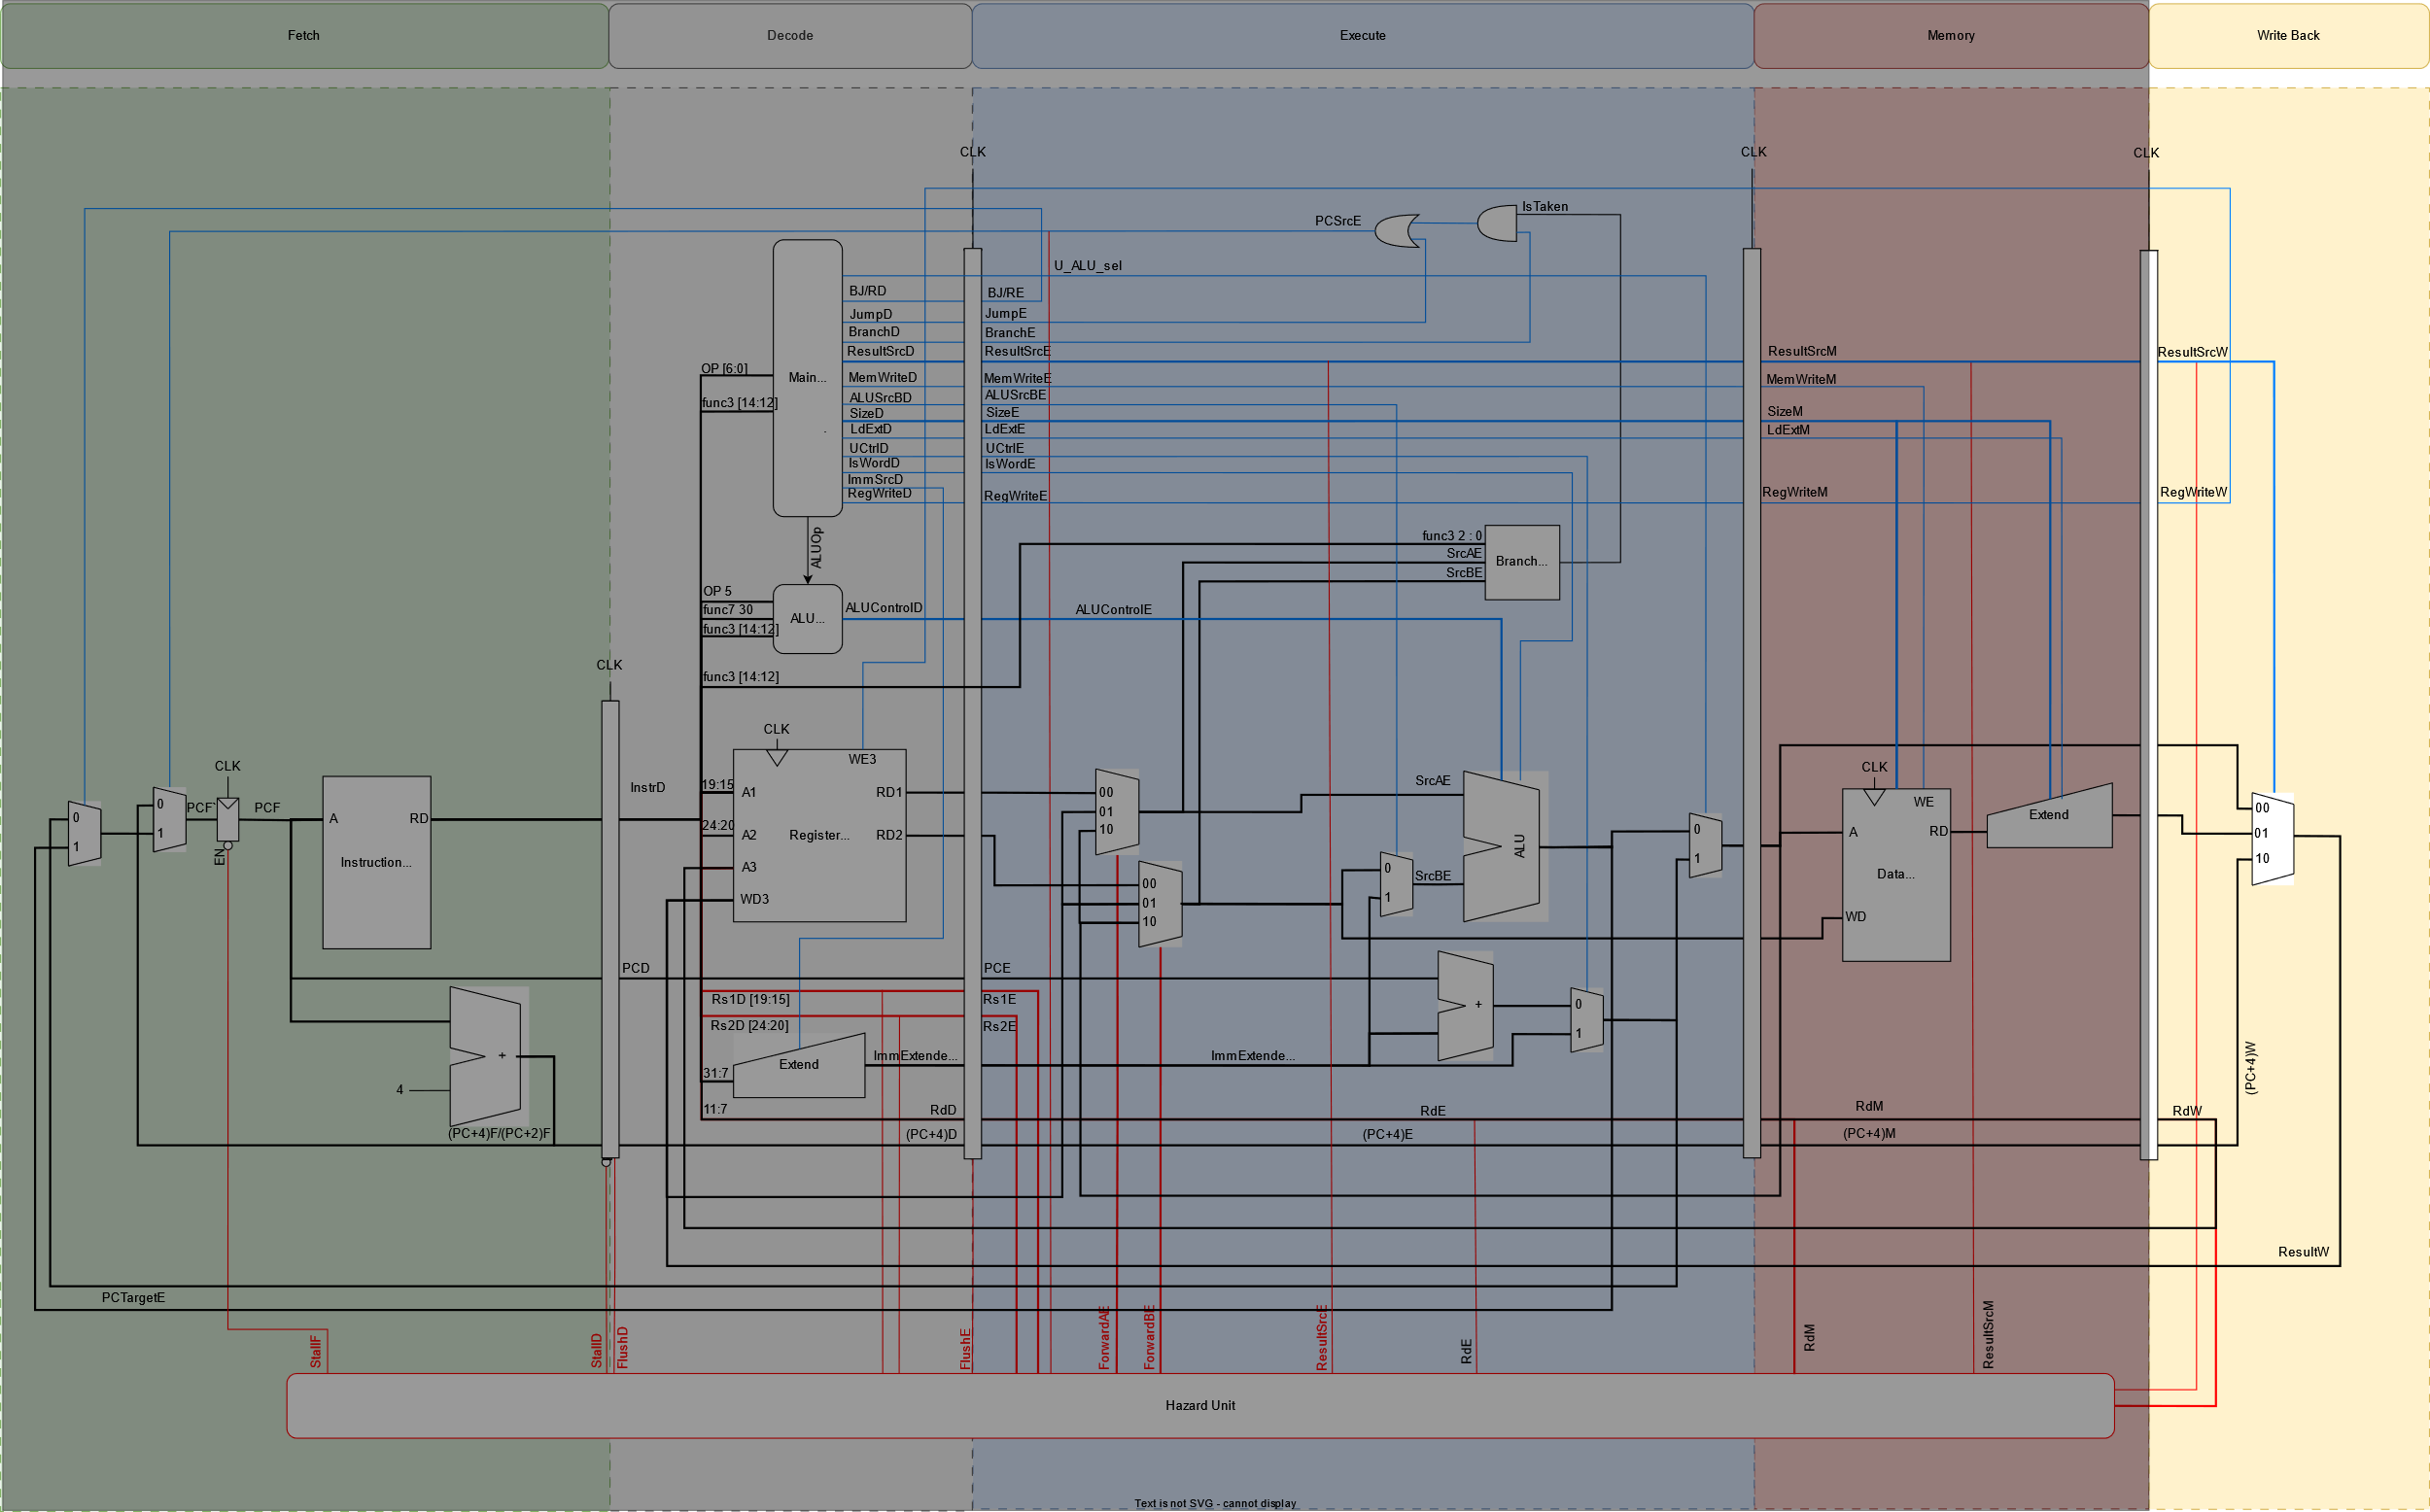
Base-I | RV64I Design: Writeback Stage

Slide 58
Base-I | RV64I Design: Writeback Stage
Writeback Mux
resultsrc | Operation
2’b00 | Writes back the data computed from EX stage
2’b01 | Writes back the data loaded from data memory
2’b10 | Writes back PC+4 for JAL & JALR instructions

Slide 59
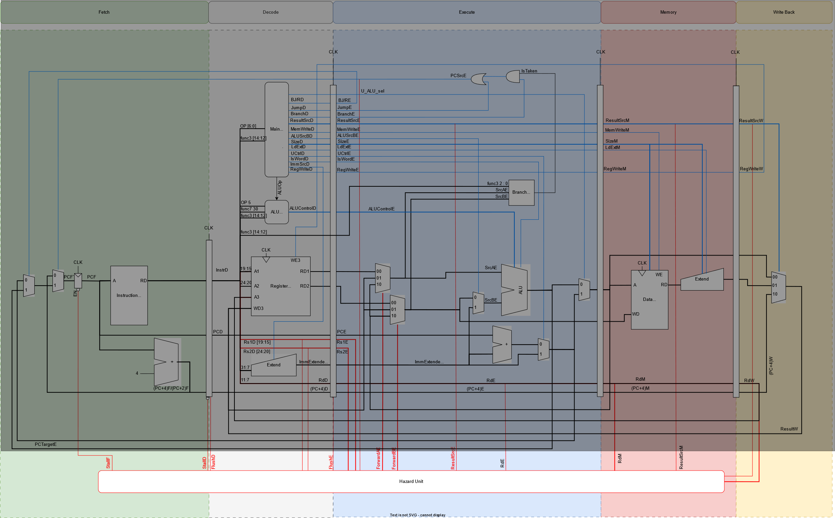
Base-I | RV64I Design: Hazard Unit

Slide 60
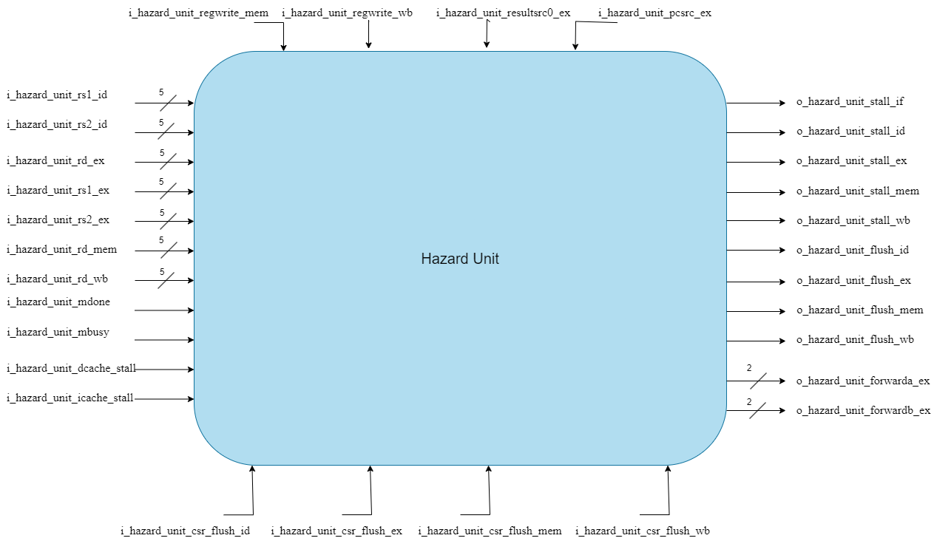
Base-I | RV64I Design: Hazard Unit
HU Block Diagram

Slide 61
Base-I | RV64I Design: Hazard Unit
I/O | Width | Description
i_hazard_unit_rs1_id | 5 | RV64I Hazard Detection Control Signals
i_hazard_unit_rs2_id | 5
i_hazard_unit_rs1_ex | 5
i_hazard_unit_rs2_ex | 5
i_hazard_unit_rd_ex | 5
i_hazard_unit_rd_mem | 5
i_hazard_unit_rd_wb | 5
i_hazard_unit_regwrite_mem | 1
i_hazard_unit_regwrite_wb | 1
i_hazard_unit_resultsrc_ex | 2
i_hazard_unit_pcsrc_ex | 1
I/O | Width | Description
i_hazard_unit_mdone | 1 | RV64M Hazard Detection Signals
i_hazard_unit_mbusy | 1
i_hazard_unit_dcache_stall | 1 | I&D Caches Hazrad Detection Signals
i_hazard_unit_icache_stall | 1
i_hazard_unit_csr_flush_id | 1 | CSR Hazard Detection Signals
i_hazard_unit_csr_flush_ex | 1
i_hazard_unit_csr_flush_mem | 1
i_hazard_unit_csr_flush_wb | 1

Slide 62
Base-I | RV64I Design: Hazard Unit
I/O | Width | Description
o_hazard_unit_forwarda_ex | 2 | Forwarding Control Signals
o_hazard_unit_forwardb_ex | 2
o_hazard_unit_stall_if | 1 | Stall Control Signals
o_hazard_unit_stall_id | 1
o_hazard_unit_stall_ex | 1
o_hazard_unit_stall_mem | 1
o_hazard_unit_stall_wb | 1
o_hazard_unit_flush_id | 1 | Flush Control Signals
o_hazard_unit_flush_ex | 1
o_hazard_unit_flush_mem | 1
o_hazard_unit_flush_wb | 1

Slide 63
Base-I | RV64I Design: Hazard Unit
For RV64I Base:
RAW data hazards occur when an instruction depends on a result that has not yet been written.
RAW can be resolved by forwarding if the result is computed soon enough.
Otherwise, stalling the pipeline until the result is available.

Slide 64
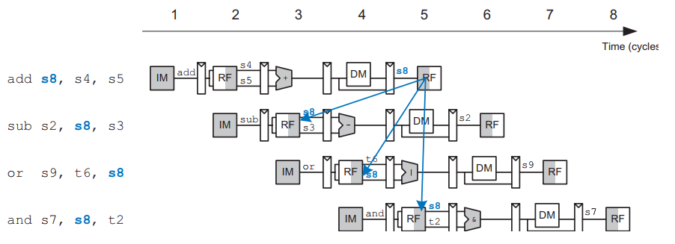
Base-I | RV64I Design: Hazard Unit
RAW Hazard Example:

Slide 65
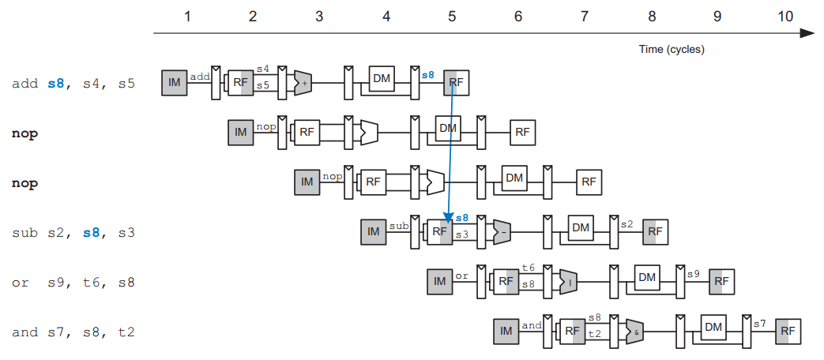
Base-I | RV64I Design: Hazard Unit
SW Solution to RAW Hazard Example:

Slide 66
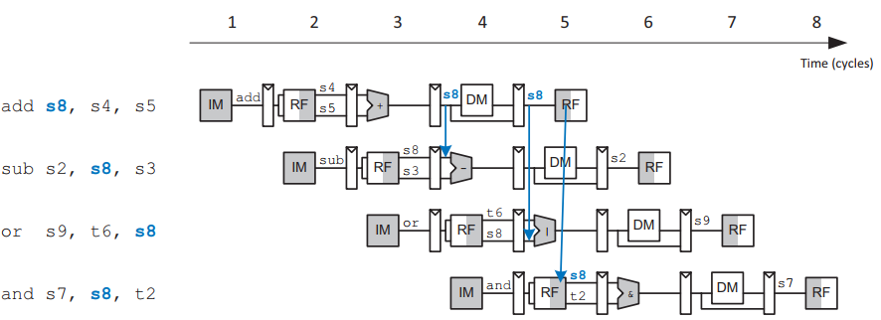
Base-I | RV64I Design: Hazard Unit
HW Solution to RAW Hazard Example: "Forwarding"

Slide 67
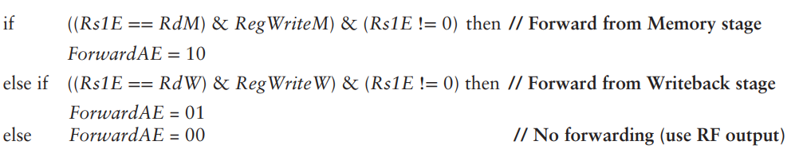
Base-I | RV64I Design: Hazard Unit
Forwarding is necessary when an instruction in the Execute stage has a source register matching the destination register of an instruction in the Memory or Writeback stage.

Slide 68
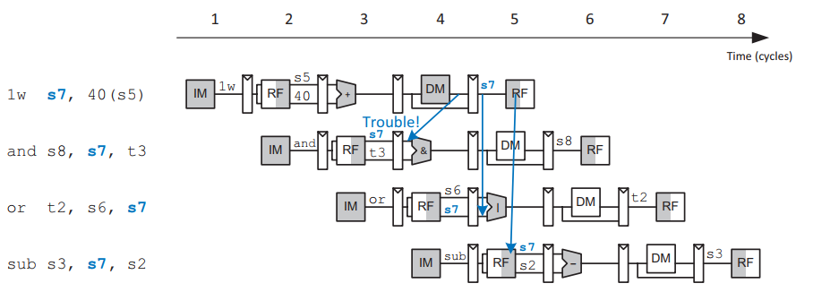
Base-I | RV64I Design: Hazard Unit
Unfortunately, the lw instruction does not finish reading data until the end of the Memory stage, so its result cannot be forwarded to the Execute stage of the next instruction.
We say that the lw instruction has a two-cycle latency.

Slide 69
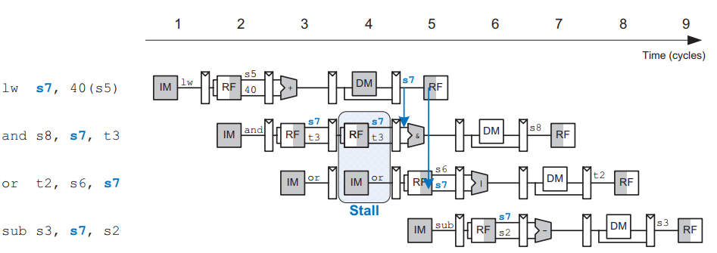
Base-I | RV64I Design: Hazard Unit
Solution to lw hazard: "Stall"

Slide 70
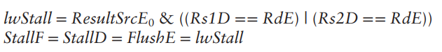
Base-I | RV64I Design: Hazard Unit
Note that the Execute stage is unused in cycle 4.
The bubble is introduced by zeroing out the Execute stage control signals during a Decode stage stall.
so that the bubble performs no action and changes no architectural state.

Slide 71
Base-I | RV64I Design: Hazard Unit
For RV64I Base:
Control hazards occur when the decision of branching has not been made by the time the next instruction must be fetched.
Control hazards can be resolved by stalling the pipeline until the decision is made or by branch prediction.
Moving the decision as early as possible minimizes the number of instructions that are flushed on a misprediction.

Slide 72
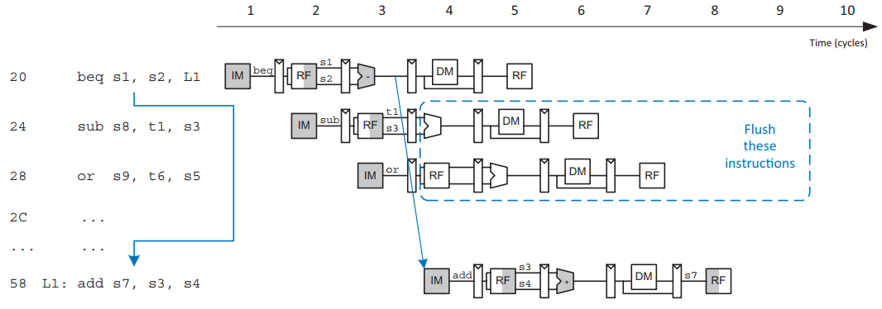
Base-I | RV64I Design: Hazard Unit
The beq instruction presents a control hazard: "Flush"

Slide 73
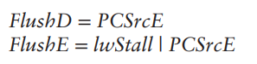
Base-I | RV64I Design: Hazard Unit
The processor predicts that branches are not taken and simply continues executing the program in order until PCSrcE is computed.

Slide 74
Base-I | RV64I Design: Hazard Unit
For RV64M:
Data Hazard occur when an instruction depends on the Multiplication/Division result.
This Data Hazard is resolved by stalling the pipeline depending on two flags from the M-extension:
m_done
m_busy

Slide 75
Base-I | RV64I Design: Hazard Unit
For Caches:
The Cache hazards occur when a cache miss happens.
The Cache hazards can be resolved by stalling the pipeline until fetching new data from the memory.

Slide 76
Base-I | RV64I Design: Hazard Unit
For CSR:
The CSR hazards occur when there is an interrupt, or an exception.
The CSR hazards can be resolved by flushing all the pipes starting from the ID pipe.

Slide 77
Chapter 3 Implementation of Compressed ISA

Slide 78
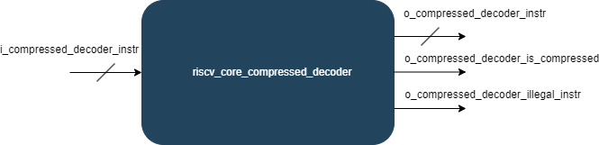
C-Extension : Compressed Decoder
Block Diagram
I/O | Width | Description
i_compressed_decoder_instr | 32 | Input Compressed/Normal Instruction.
o_compressed_decoder_instr | 32 | Output Compressed/Normal Instruction.
o_compressed_decoder_is_compressed | 1 | Output Flag indicates that the input instruction is compressed.
o_compressed_decoder_illegal_instr | 1 | Output Flag indicates that the input instruction is illegal.

Slide 79
C-Extension : Compressed Decoder
This chapter describes the RVC-Extension which reduces the size of common integer instructions to 16 bits.
By reducing the sizes of the control, immediate, and register fields.
The subset was selected to cover the most used instructions in their most used form.
C extension decreases cost, power, and required memory.

Slide 80
C-Extension : Compressed Decoder
According to the RISC-V Instruction Set Manual, typically 50% to 60% of a program’s instructions can be replaced with RVC instructions, resulting in a 25%–30% code-size reduction.
The C extension allows 16-bit instructions to be freely intermixed with 32-bit instructions.
The decoder checks on the two LSBs, "11" is the normal 32-bit instruction encoding.

Slide 81
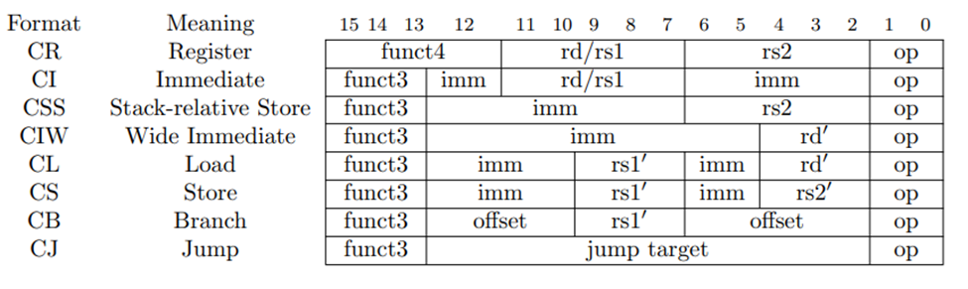
C-Extension : Compressed Decoder
Compressed Instruction Formats:
CR, CI, and CSS can use any of the 32 RVI registers.
CIW, CL, CS, CA, and CB are limited to just 8 of them.

Slide 82
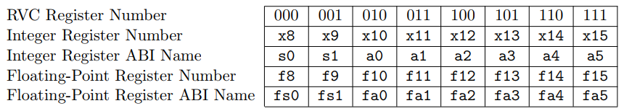
C-Extension : Compressed Decoder
Registers specified by the three-bit rs1 ′, rs2 ′, and rd ′ fields of the CIW, CL, CS, CA, and CB formats:
these popular registers, which correspond to registers x8 to x15.

Slide 83
C-Extension : Compressed Decoder
The formats were designed to:
keep bits for the two source registers in the same place in all instructions.
When the full 5-bit destination register specifier is present, it is in the same place as in the 32-bit RISC-V encoding.
Otherwise, the destination register field can move.
Immediate fields have been scrambled, as in the base specification, to reduce the number of immediate muxes required.
RVC Instruction Set is divided to 4-quadrants of the encoding space.
The last quadrant "11" is the normal 32-bit instruction.

Slide 84
C-Extension : Compressed Decoder
Several instructions are only valid for certain operands; when invalid, they are marked either:
RES to indicate that the opcode is reserved for future standard extensions.
NSE to indicate that the opcode is reserved for custom extensions.
HINT to indicate that the opcode is reserved for microarchitectural hints.
HINTs instructions do not modify any architectural state and are executed as no-ops on implementations that ignore them.
Example:
rd=x0 (e.g. C.ADD x0, t0).
rd is overwritten with a copy of itself (e.g. C.ADDI t0, 0).

Slide 85
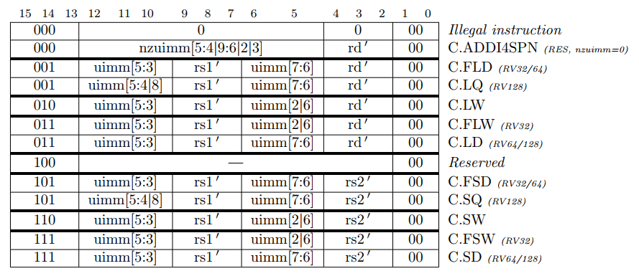
C-Extension : Compressed Decoder
RVC Instruction Set Listings for Quadrant-0

Slide 86
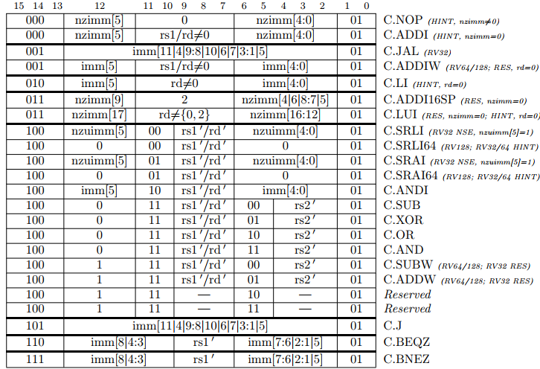
C-Extension : Compressed Decoder
RVC Instruction Set Listings for Quadrant-1

Slide 87
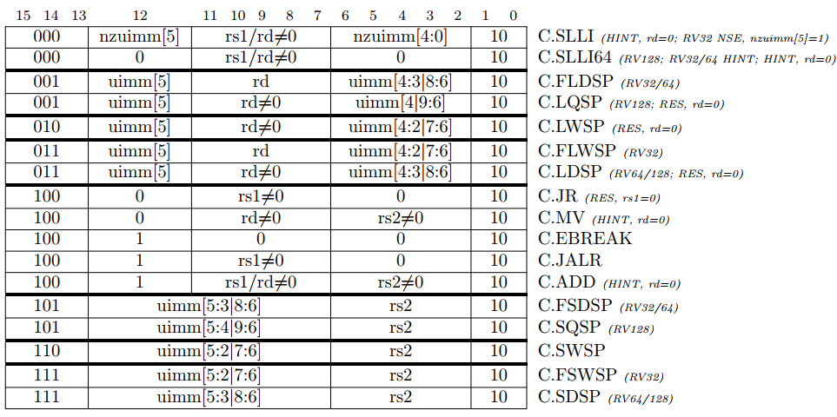
C-Extension : Compressed Decoder
RVC Instruction Set Listings for Quadrant-2

Slide 88
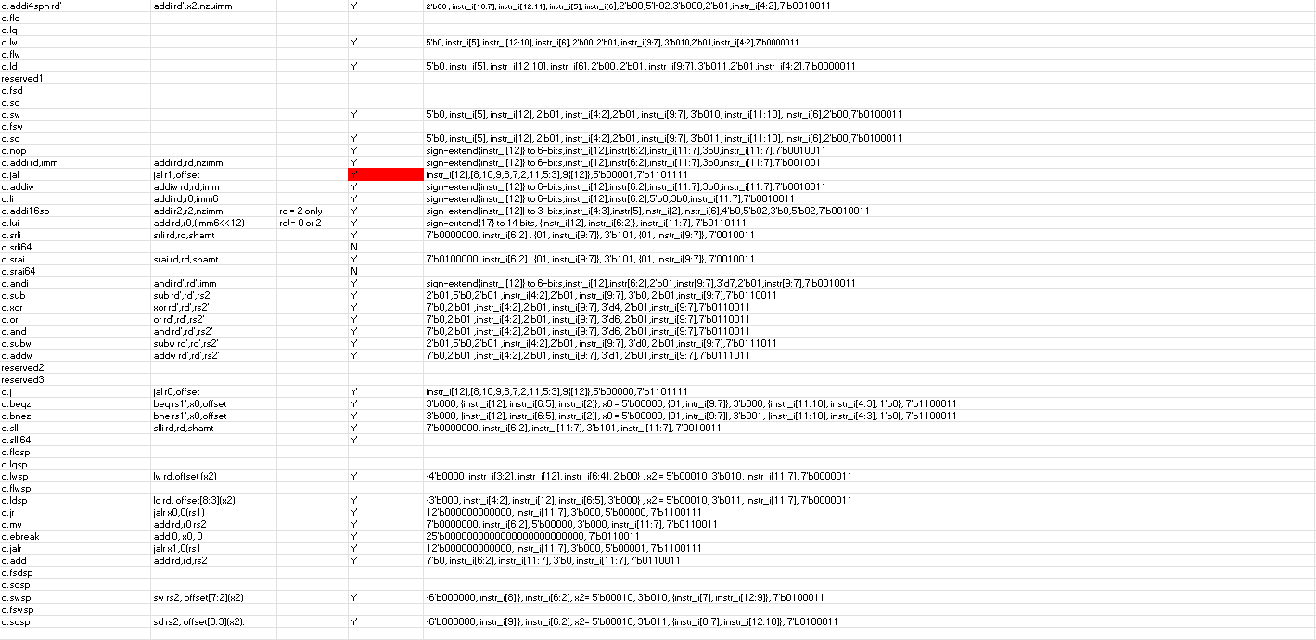
C-Extension : Compressed Decoder
RVC Expansion to RVI:Sheet Link

Slide 89
Chapter 4 Implementation of M ISA

Slide 90
Integer Multiplication And Division Instructions Extension
RV64M ISA introduces a total of thirteen multiplication and division instructions as shown in the table.
Instruction | Format | Opcode | Funct3 | Funct7 | Description
mul | R | 0110011 | 0x0 | 0x01 | rd = (rs1 * rs2)[63:0]
mulh | R | 0110011 | 0x1 | 0x01 | rd = (rs1 * rs2)[127:64]
mulhsu | R | 0110011 | 0x2 | 0x01 | rd = (rs1 * rs2)[127:64]
mulhu | R | 0110011 | 0x3 | 0x01 | rd = (rs1 * rs2)[127:64]
div | R | 0110011 | 0x4 | 0x01 | rd = rs1 / rs2
divu | R | 0110011 | 0x5 | 0x01 | rd = rs1 / rs2

Slide 91
Integer Multiplication And Division Instructions Extension
Instruction | Fromat | Opcade | Funct3 | Funct7 | Description
rem | R | 0110011 | 0x6 | 0x01 | rd = rs1 % rs2
remu | R | 0110011 | 0x7 | 0x01 | rd = rs1 % rs2
mulw | R | 0111011 | 0x0 | 0x01 | rd = rs1[31:0] * rs2[31:0] (sign extend)
divw | R | 0111011 | 0x4 | 0x01 | rd = rs1[31:0] / rs2[31:0] (sign extend)
divuw | R | 0111011 | 0x5 | 0x01 | rd = rs1[31:0] / rs2[31:0] (sign extend)
remw | R | 0111011 | 0x6 | 0x01 | rd = rs1[31:0] % rs2[31:0] (sign extend)
remuw | R | 0111011 | 0x7 | 0x01 | rd = rs1[31:0] % rs2[31:0] (sign extend)

Slide 92
Control Signals of M-Extension
Control Signal from main decoder:
IM_Sel: it acts as an enable signal for the M-extension block and as a select signal for a 2x1 multiplexer. This mux chooses between the output of the M-extension block and the ALU block.
IsWord: specifies the word instructions
Control Signal from ALU decoder:
ALUControl: 4-bit signal to specify one instruction from M-extension instruction

Slide 93
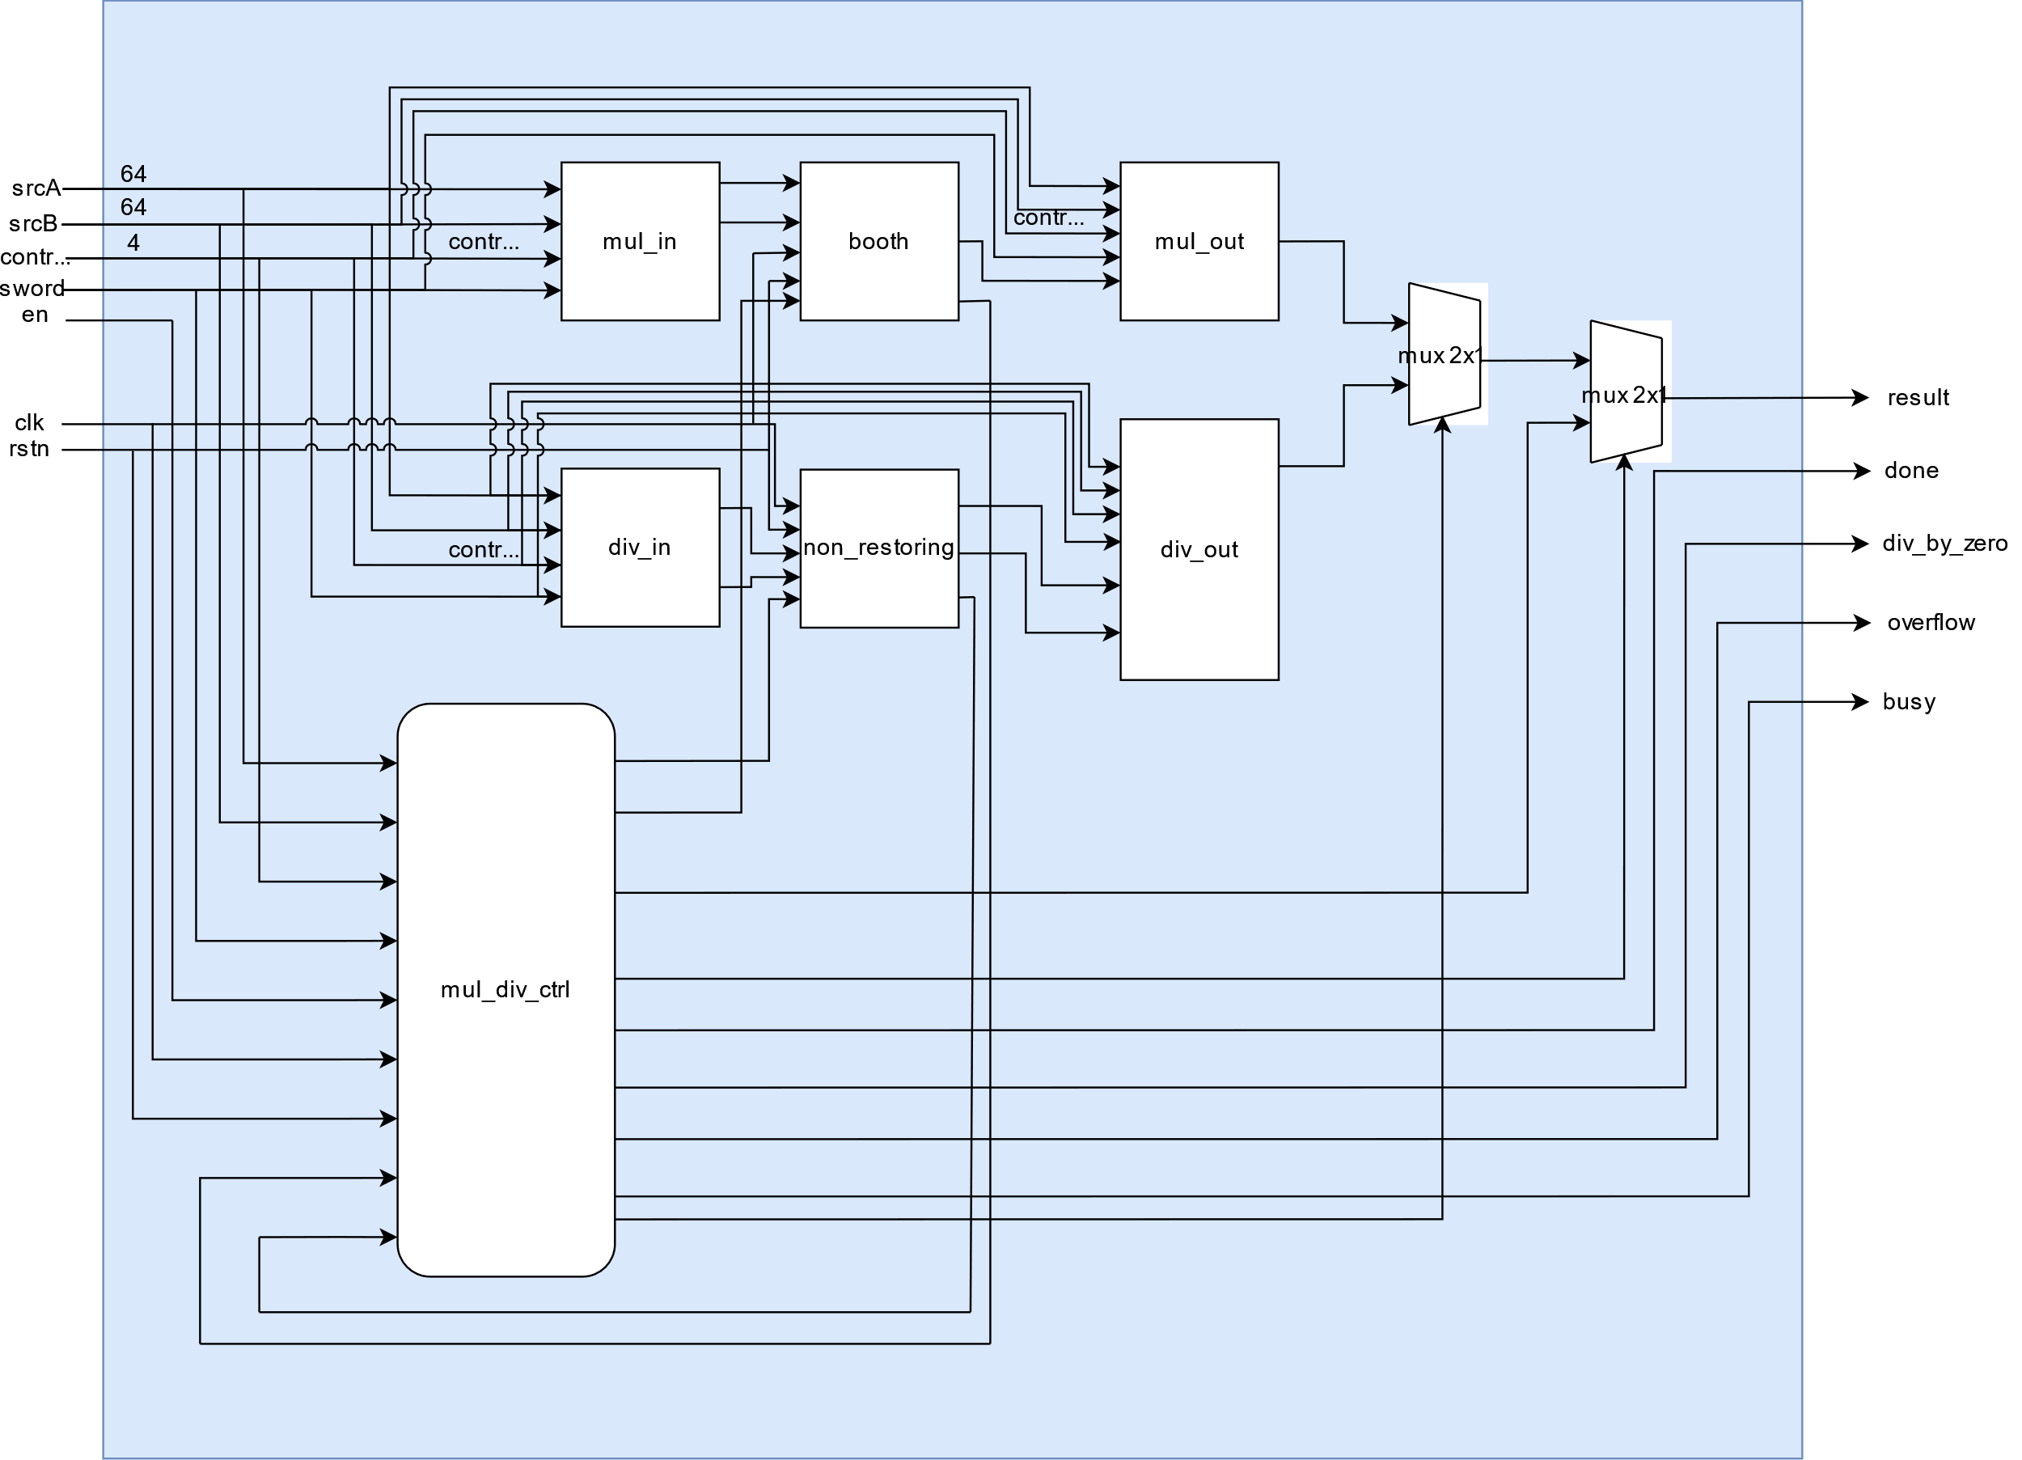
Microarchitecture of M-Extension.

Slide 94
Microarchitecture of M-Extension.
The microarchitecture consists of:
Input Blocks
Multiplication and Division Blocks
Performing unsigned operations
Output blocks
Controller

Slide 95
Multiplier
Mul_in Block:
adjust the two inputs srcA and srcB to get the proper multiplicand and multiplier

Slide 96
Multiplier
Each instruction needs a proper adjustment.
mul and mulh: if either one of the two inputs is negative, get its positive value using two’s complement.
mulhsu: if the multiplicand is negative, get its positive value using two’s complement.
mulhu: no adjustment needed.
mulw: take only the first 32-bit since it’s a word operation and get the positive value if there is a negative input.

Slide 97
Multiplier
Booth Block:
Performs the multiplication using fast algorithm

Slide 98
Multiplier
Multiplier Algorithm:
Initialization
Load the multiplier.
Set the counter to 64 (for 64-bit multiplication).
Iterative Multiplication in MUL State:
Check the LSB of the multiplier.
If 1, add the multiplicand to the accumulator, if 0, do nothing
Perform an arithmetic right shift on the combined registers {carry, accumulator, and multiplier}.
Decrement counter.
Result
If the counter reaches 0, the result is in the combined accumulator and multiplier.

Slide 99
Multiplier
Mul_out Block:
responsible for adjusting the sign of the product result of the signed instructions (Mul, Mulh, Mulhsu and Mulw).

Slide 100
Divider
Div_in Block:
Same as the multiplier we need to adjust the inputs of the operation, Since the non-restoring algorithm is unsigned

Slide 101
Divider
Non_restoring block:
responsible for performing the division.

Slide 102
Divider
Non-Restoring Algorithm:

Slide 103
Divider
Non-Restoring Algorithm:

Slide 104
Divider
Non-Restoring Division Steps:
In this step, the corresponding values are initialized in the registers as follows: register A is set to 0, register M holds the Divisor, register Q contains the Dividend, and N specifies the number of bits in the Dividend.
In this step, we will check the sign bit of A.
If the bit in register A is 1, shift the combined value of AQ to the left and perform the operation A = A + M. If the bit is 0, shift the combined value of AQ to the left and perform the operation A = A - M. In the case of 0, this involves adding the 2's complement of M to register A, with the result stored in A.

Slide 105
Divider
Non-Restoring Division Steps:
check the sign bit of A again.
If the bit in register A is 1, then Q[0] will be set to 0. If the bit is 0, then Q[0] will be set to 1. Here, Q[0] refers to the least significant bit of Q.
Then, the value of N, which serves as a counter, will be decremented.
If the value of N = 0, then we will go to the next step. Otherwise, we must again go to step 2.
If the sign bit of register A is 1, we will execute A = A + M.
In this step, register A holds the remainder, and register Q contains the quotient.

Slide 106
Divider
Div_out Block:
responsible for adjusting the sign of the product result of the signed instructions (div, divw, rem and remw).
Assign the quotient or the remainder to the output of the block according to the instruction (division or remainder)

Slide 107
M-Extension Controller
Its primary role is to ensure efficient and accurate execution of M-Extension instructions by coordinating the necessary control signals and handling data flow within the processor.
The controller optimizes performance by implementing fast paths for simple operations (fast operations).

Slide 108
M-Extension Controller
The finite state machine of the controller block which have four states:
IDLE
MUL: Performs multiplication
DIV: Performs division
FAST: Performs fast operations

Slide 109
M-Extension Controller

Slide 110
M-Extension Controller
Block Diagram:

Slide 111
M-Extension Controller
Fast Operations:
We added Another feature to the implementation of the M-Extension, which is fast operations, fast operations mean preforming the basic operations during only one clock cycle and not waiting 64 clock cycles.
We created two registers, one for double word instructions and the other for word instructions. Each one is 7-bit wide. These two registers indicate whether one of the operands is -1, 0, 1, or indicate an overflow value.
Fast DW Reg | B = -1 | B = 1 | B = 0 | A = -1 | A = 1 | A = 0 | Overflow
Fast W Reg | B = -1 | B = 1 | B = 0 | A = -1 | A = 1 | A = 0 | Overflow

Slide 112
M-Extension Controller
Assuming A is the dividend or multiplicand, and B is divisor or multiplier, then, Fast operations are as shown in the below table
Fast_reg | Instr | Operation | Fast_out
7’b1000001 | REM | Overflow | 0
 | DIV |  | 64’h8000_0000_0000_0000
7'b001xxx0 | REM(U) | A%0 | A
 | DIV(U) | A/0 | 64’hFFFF_FFFF_FFFF_FFFF

Slide 113
M-Extension Controller
Fast Reg | Instruction | Operation | Fast_Out
7'b1000000 | REM(U) | A%-1 | 0
 | DIV(U) | A/-1 | 2’s comp of A
 | MUL | A*-1 | 2’s comp of A
 | MULH(SU)(U) |  | 64’hFFFF_FFFF_FFFF_FFFF
7’b0100000 | REM(U) | A%1 | 0
 | DIV(U) | A/1 | A
 | MUL | A*1 | A
 | MULH(SU)(U) |  | not fast operation
7'b1001000 | REM(U) | -1%-1 | 0
 | DIV(U) | -1/-1 | 1
 | MUL | -1*-1 | 1
 | MULH |  | 0
 | MULHSU(U) |  | not fast operation

Slide 114
M-Extension Controller
Fast Reg | Instruction | Operation | Fast_out
7'b1000100 | REM(U) | 1%-1 | 0
 | DIV(U) | 1/-1 | -1
 | MUL | 1*-1 | -1
 | MULH |  | -1
 | MULHSU(U) |  | not fast operation
7'b0101000 | REM(U) | -1%1 | 0
 | DIV(U) | -1/1 | not fast operation
 | MUL | -1*1 | -1
 | MULH |  | 0
 | MULHSU(U) |  | -1
7'b0000100 | REM(U) | 1%B | 1
 | DIV(U) | 1/B | 0
 | MUL | 1*B | B
 | MULH(SU)(U) |  | 0

Slide 115
M-Extension Controller
Output flag signals:
Done: Indicates that an operation has completed.
Div_by_zero: Indicates a division by zero has occurred.
Overflow: Indicates that an overflow has occurred.
Busy: Indicates that M unit is currently busy.

Slide 116
Chapter 5 Caches and Atomic ISA

Slide 117
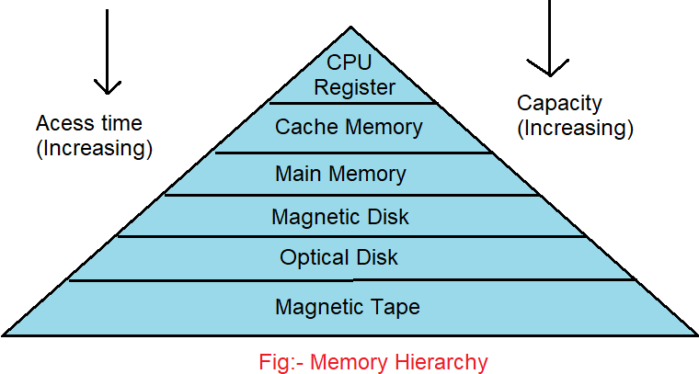
Memory Hierarchy
These memory hierarchy components are attached to the processor in a
hierarchical fashion to provide an overall storage system that
approximates the five idealisms infinite capacity, infinite bandwidth, zero latency, persistence, and zero cost as closely as possible.

Slide 118
Locality principles:
The memory-access patterns of programs are not random.
Accesses tend to repeat themselves in time and/or be near each other in the memory address space.
we have observed that a program’s memory references tend to be localized in time and space.

Slide 119
Locality principles:
Temporal Locality
Spatial Locality
the tendency of programs to use data items over and again during their execution
Spatial locality arises because of the tendency of programmers and compilers to cluster related objects together in the memory space.

Slide 120
Caches Organization and Design:
Q1: Where can a block be placed in the upper level? (block placement)
Q2: How is a block found if it is in the upper level? (block identification)
Q3: Which block should be replaced on a miss? (block replacement)
Q4: What happens on a write? (write strategy)

Slide 121
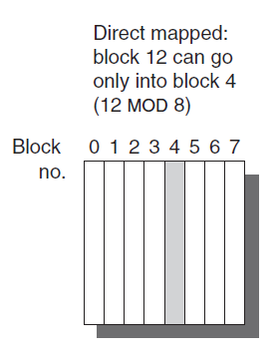
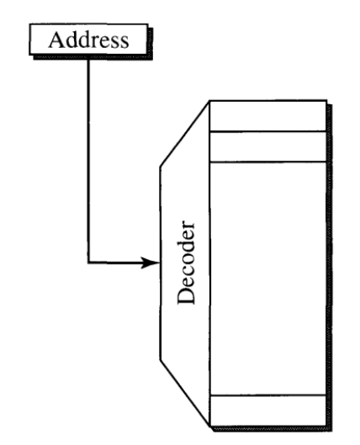
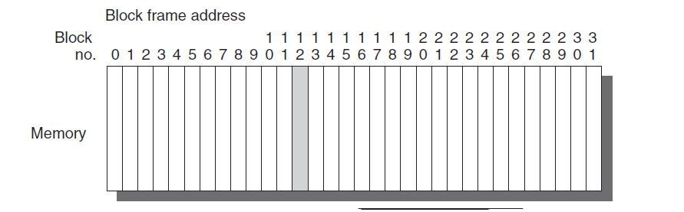
Block Placement
We have several types of block placement
Direct Mapping : If each block has only one place it can appear in the cache, the cache is said to be direct mapped.

Slide 122
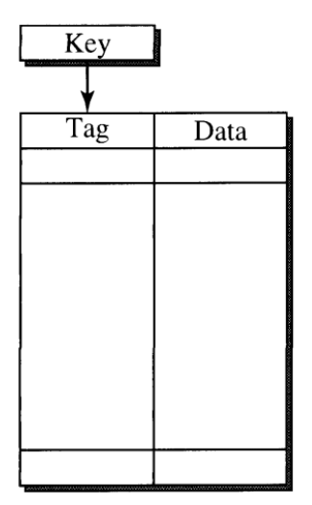
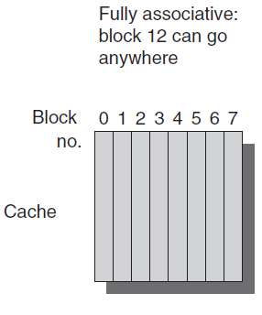
Block Placement
Fully Associative : Each block in the memory can be mapped to any block on the cache.

Slide 123
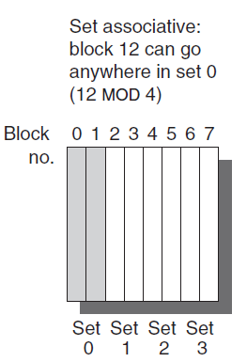
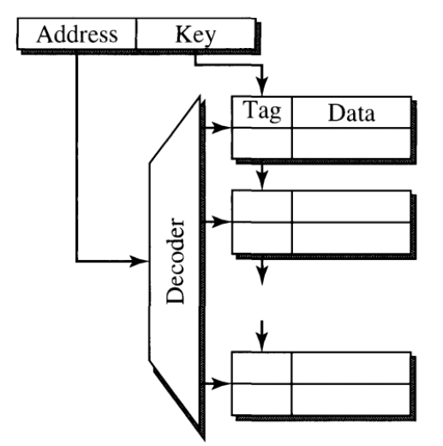
Block Placement
N way set associative: Caches are divided into sets and each set has N number of blocks where a block in the main memory is mapped to a certain set and placed anywhere in the set.

Slide 124
Where can a block be placed in the upper level?
For our core, we will choose Direct Mapping for the Caches, so it is easy to implement and not complicate the design as we have only a single core.

Slide 125
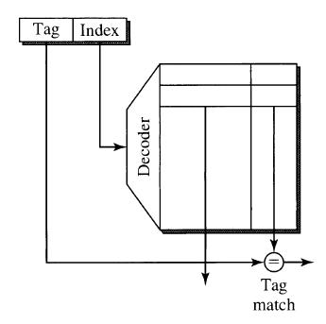
Block Identification
The address as we know in direct mapping is mapped to a certain location in the cache, so it is considered a many-to-one mapping.
So, to access a desired location to see if it is a miss or a hit, we will divide the address to : Index and Tag.
It is worth to notice that only one comparison operation is done

Slide 126
Block Replacement
When a miss occurs, then we should get the desired block from the memory and so we need to put in replacement of another block.
In our desire in direct mapping cache , we won’t need any algorithm since for a block to be placed it has only one place to be placed in (many-to-one mapping) so it is placed in that location anyway.
In simple words: Only one block frame is checked for a hit, and only that block can be replaced if it is a miss.

Slide 127
Write Strategy
The write policies often distinguish cache designs. There are two basic options when writing to the cache:
Write-through :The information is written to both the block in the cache and to the block in the lower-level memory.
Write-back : The information is written only to the block in the cache. The modified cache block is written to main memory only when it is replaced.
We will choose the Write-through as it has the advantage that the next lower level has the most current copy of the data, which simplifies data coherency which is important for I/O.

Slide 128
Write Strategy
What happens if the cache doesn’t have the location to be written to ? (write miss).
We have to policies :
Write allocate : The block is allocated on a write miss, followed by the write hit actions above. In this natural option, write misses act like read misses.
No-write allocate : This apparently unusual alternative is write misses do not affect the cache. Instead, the block is modified only in the lower-level memory.
We will choose the Write allocate in our cache as it is most probably a store instruction is followed by a load for that same address place again.

Slide 129
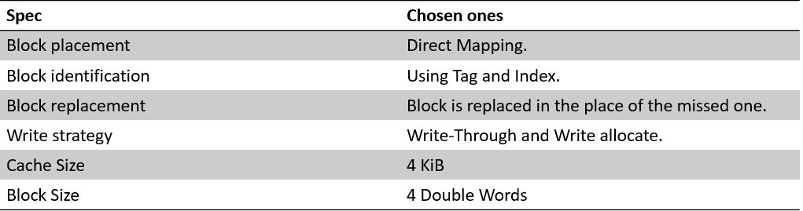
Conclusion

Slide 130
Instruction Cache
Its Implementation is the same as Data Cache but with no writing mechanism and it is always reading from the address provided as long as it is a cache hit.

Slide 131
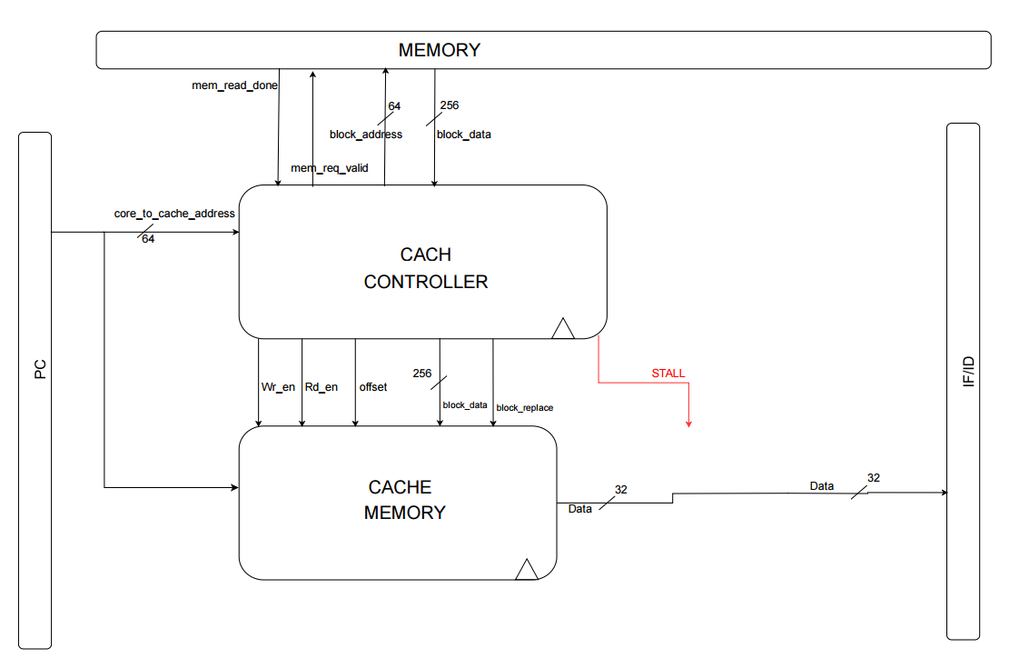
Microarchitecture

Slide 132
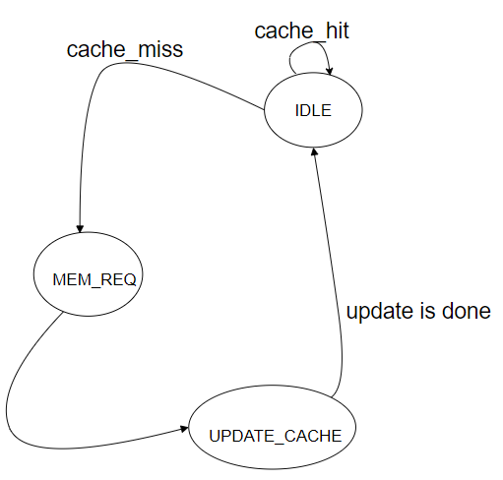
Cache States

Slide 133
Added Signals
Since we have Compressed instructions, we jump 2 locations when we encounter such an instruction.
This may cause an instruction to be present in TWO
different cache lines.
That can happen when 2 bytes are in the last 2 bytes of a line and the other 2 bytes are at the beginning of the next cache line.
To solve this problem, we added the OFFSET signal

Slide 134
OFFSET signal
Address 1
Address 2

Slide 135
DATA CACHE
Unlike the instruction cache, the data cache has more control signals and have writing mechanism.
We started by implementing the data cache without Atomic instructions, then we extended our implementation to the A extension.

Slide 136
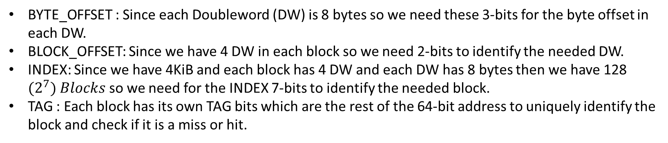
Cache Address Specs
[63:12] | [11:5] | [4:3] | [2:0]
TAG | INDEX | BLOCK_OFFSET | BYTE_OFFSET
BYTE_OFFSET : Since each Doubleword (DW) is 8 bytes so we need these 3-bits for the byte offset in each DW.
BLOCK_OFFSET: Since we have 4 DW in each block so we need 2-bits to identify the needed DW.
INDEX: Since we have 4KiB and each block has 4 DW and each DW has 8 bytes then we have 128 ${(2}^{7}) Blocks$ so we need for the INDEX 7-bits to identify the needed block.
TAG : Each block has its own TAG bits which are the rest of the 64-bit address to uniquely identify the block and check if it is a miss or hit.

Slide 137

Data Cache Block Diagram

Slide 138
Data Cache Controller States
Load && cache_hit
cache_miss
store instruction
IDLE
MEM_WRITE
write is done
MEM_REQ
update is done
UPDATE_CACHE

Slide 139

Some Cache Cases: Read Hit

Slide 140

Read Miss

Slide 141

Write Hit

Slide 142
Atomic Extension “A”
lr.w | sc.w | amoswap.w | amoadd.w | amoand.w | amoor.w | amoxor.w | amomax.w | amomin.w | amomaxu.w | amominu.w
lr.d | sc.d | amoswap.d | amoadd.d | amoand.d | amoor.d | amoxor.d | amomax.d | amomin.d | amomaxu.d | amominu.d
The standard atomic-instruction extension, named “A”, contains instructions that atomically
read-modify-write memory to support synchronization between multiple RISC-V harts running
in the same memory space.
The two forms of atomic instruction provided are load-reserved/store-conditional
instructions and atomic fetch-and-op memory instructions.

Slide 143
Atomic Extension “A”
LR/SC : “LR” is x[rd] = MEM[x[rs1]] AND then locks MEM[x[rs1]]
“SC” puts on x[rd] zero if store is succussed and non-zero if failure
For AMO: it can be divided in 3 separate instructions as follows:
Load
Operation
Store
x[rd] = MEM[x[rs1]] , MEM[x[rs1]] = MEM[x[rs1]] OPERATION x[rs2]
Load
Store
Operation

Slide 144

Modified Data Cache For “A” Extension

Slide 145
Modified Data Cache Controller States
amo instruction
AMO_OP
Load && cache_hit
cache_miss
IDLE
store instruction
MEM_WRITE
write is done
MEM_REQ
update is done
UPDATE_CACHE

Slide 146

Note on MEM_WRITE State in atomic
Since we have the write happens with positive edge with clock, when we have AMO, we write in the main memory first before the cache unlike the ordinary store.
That’s because we don’t want to override the old data before it reaches the rd.
So, when the “write_done” comes, we rise “i_write” from controller to memory and release “stall” so that next positive edge, old data passes to WB Stage and AMO result is written inside cache.

Slide 147
Caches and Main Memory
Since we have 2 read ports (for the case of cache miss) one for each cache, and 1 write port for data cache, we need to determine how the interface with our main memory will be.
After reviewing "Modular Multi-Ported SRAM-based Memories," in Proceedings of the 2014 ACM/SIGDA International Symposium on Field-programmable Gate Arrays (FPGA '2014), February 2014 by Ameer M.S. Abdelhadi and Guy G.F. Lemieux, We decided to use the memory arbiter approach to serve both caches.

Slide 148

Memory Arbiter
We implemented the main memory on the Block Ram (BRAM) of our FPGA.
We partitioned the Main Memory into instruction part and data part.
The instruction memory starts at address 0x000000000, and the data memory starts at address 0x001000000.
The Memory Arbiter serves both the instruction and data caches at cache misses and when data cache wants to write on main memory.

Slide 149
Block Diagram for Memory Arbiter
64-
bit
256-
bit
block_data
i_cache_interface
mem_read_req
64-
bit
block_address
mem_read_done
256-
bit
block_data
mem_read_req
64-
bit
block_address
mem_read_done
64-
bit
mem_write_data
MAIN_MEM
256-
bit
block_data
mem_write_req
MEM_ARBITER
mem_read_req
8-
bit
mem_write_strobe
mem_read_done
64-
bit
mem_write_address
d_cache_interface
64-
bit
mem_write_data
mem_write_done
mem_write_req
8-
bit
mem_write_strobe
64-
bit
mem_write_address
mem_write_done

Slide 150
Branch Prediction in RISC-V
Branch Penalties limit the performance of the core and increases CPI beyond 1.
Branch prediction with high accuracy can reduce branch penalties.

Slide 151
What is Control Transfer?
Control Transfer instructions causes the program flow to change to another address in the instruction memory.
This means we have two things to determine to execute these instructions:
Decision ( Taken or Not Taken)
Target Address

Slide 152

Static Prediction
First type of prediction is static prediction by always take the same decision for all control flow instructions.
Overall probability a branch is taken is ~60-70% with the following distribution according to the direction of branch.

Slide 153

Static Predictor
By this previous knowledge, the design of static predictor block can be as follows:
Take the Jump when the instruction is decoded as Unconditional Jump.
Prefer the backward branch, by taking the branch if the offset is negative.
We will put predictor in the ID Stage.

Slide 154
Static Prediction Accuracy
The accuracy of Static Predictor ranges from 50 to 80 % , in addition to at least 1 bubble is introduced either the prediction is right or wrong.
Therefore, we need another type for better accuracy and performance

Slide 155
Dynamic Prediction
Dynamic Prediction makes use of the actual branch decisions to update itself and dynamically perform better.
How is that achieved?

Slide 156
Introducing Branch History Table (BHT)
It is a table that contains all previous control transfer instructions according to their corresponding PC.
For each prediction , BHT updates its next decision by comparing its prediction with the actual right decision produced from the Branch Unit.
It uses a Two-Bit Counter to update its decision every time the same branch instruction is encountered.

Slide 157

Two Bit Counter
It is an FSM that updates the decision of each branch instruction according to past behavior.
If the current state is strong taken or weak taken, then the decision is to take the branch. Otherwise , it is not taken.
According to the output of the branch unit in the EX-stage to that branch instruction, the state is updated.

Slide 158
How BHT works
Assume a Loop with 10 iterations, first time is mis predicted.
Valid | Two Bit Saturation
0 | 00
0 | 00
0 | 00
0 | 00

Slide 159
After 1st Branch encounter with TAKEN decision
Also , Second time is mis predicted.
Valid | Two Bit Saturation
1 | 01
0 | 00
0 | 00
0 | 00

Slide 160
After 2nd Branch encounter with TAKEN decision
Next Prediction will be “Taken” for the rest of the Loop Iterations.
Valid | Two Bit Saturation
1 | 10
0 | 00
0 | 00
0 | 00

Slide 161
After 3rd Branch encounter with TAKEN decision
Valid | Two Bit Saturation
1 | 11
0 | 00
0 | 00
0 | 00
Strongly Taken

Slide 162
After first NOT TAKEN decision at the end of the Loop
If the Loop is initialized again , it will be predicted right from the first time!
Valid | Two Bit Saturation
1 | 10
0 | 00
0 | 00
0 | 00
Weak Taken

Slide 163
Decision Prediction is Done!
Now we solved half of the problem but, we want to know where to go if the branch is taken ?

Slide 164
Introducing: Branch Target Buffer (BTB)
From the past behavior of the branch instruction , we can also determine the Target address to branch to.
Also, for JALR instruction the Target address can be changed every few times the instruction is encountered.
BTB saves the Target Address of the branch instructions according to the PC of it.

Slide 165
How BTB works
Valid | Target address
0 | 32’h0000_0000
0 | 32’h0000_0000
0 | 32’h0000_0000
0 | 32’h0000_0000

Slide 166
After 1st Branch encounter
Valid | Target address
1 | 32’h0008_0F00
0 | 32’h0000_0000
0 | 32’h0000_0000
0 | 32’h0000_0000

Slide 167
Added Modules for Dynamic Branch Prediction
We added the following Modules :
Branch Predictor : in the IF stage.
Branch Recovery : in the EX stage
Next PC Logic : in the IF stage

Slide 168

Branch Predictor

Slide 169

Branch Prediction Address Specs
[63:10] | [9:1]
TAG | INDEX
INDEX: We have 512 ${(2}^{9}) Blocks$ so we need for the INDEX 9-bits to identify the needed block starting from bit “1” as bit “0” is always zero.
TAG : Each block has its own TAG bits which are the rest of the 64-bit address to uniquely identify the block and check if it is a miss or hit.

Slide 170
Branch Prediction Entry Contents
Valid | TAG | Saturation Bits | Target Address
1-bit | 54-bits | 2-bits | 64-bits
Valid: To indicate that the entry has a valid branch instruction contents.
TAG: To check that current PC is same as entry contents.
Saturation Bits: Two-bit saturation to save branch history decision.
Target Address: To indicate the Target address in case of prediction Taken.

Slide 171

Branch Recovery
flush

Slide 172

Next PC Logic

Slide 173
Dynamic Prediction Accuracy
By using BHT and BTB , prediction accuracy can range from 80 to 95% which will increase our performance ,decrease bubbles and help in limiting the CPI to 1.

Slide 174
Chapter 6 Privileged architecture

Slide 175
Importance of privileged ISA
In order to run an operating system on our microprocessor, we need to implement the privileged architecture, which provides three main capabilities:
Security and isolation
Context switching
Trap handling

Slide 176

Privileged software stack
RISC-V can support multiple of software stacks, but since we are targeting to run a LINUX-OS, we chose the implementation stack shown in figure.
It provides clean split between
Layers of the software stack

Slide 177

Privileged software stack
This configuration shows that a conventional operating system can support multiprogrammed execution of multiple application.

Slide 178
Privilege levels
At any time, the core is running at some privilege level encoded as a mode in one or more CSRs (control and status registers).
Three RISC-V privilege levels are currently defined as shown in table
Level | Encoding | Name | Abbreviation
0 | 00 | User/application | U
1 | 01 | Supervisor | S
2 | 10 | Reserved
3 | 11 | Machine | M

Slide 179
CSRs
Each privileged mode adds a few operations, and Control/Status Registers (CSRs) that control operations.
CSRs are mode-sensitive, accessible only by code running at a specific privilege mode or higher.
There are (often) multiple CSR copies/views for each mode.
Control/Status Regs (CSRs) have their own address space.

Slide 180
CSR address space
The standard RISC-V ISA sets aside a 12-bit encoding space (csr[11:0]) for up to 4,096 CSRs. By convention, the upper 4 bits of the CSR address (csr[11:8]) are used to encode the read and write accessibility of the CSRs.
The top two bits (csr[11:10]) indicate whether the register is read/write (00, 01, or 10) or read-only (11). The next two bits (csr[9:8]) encode the lowest privilege level that can access the CSR.

Slide 181
Machine-level ISA
The machine level has the highest privileges and is the only mandatory privilege level for a RISC-V hardware platform.
Machine mode has access to all the underlying hardware.
Machine-Level CSRs provide essential information and functionalities to the core.

Slide 182
Machine-level ISA
Here's a subset of the implemented machine-mode CSRs:
Trap setup | Mstatus, medeleg, mideleg, mtvec, mie
Trap handling | Mepc, mip, mcause, mtval, mscratch

Slide 183
Supervisor-level ISA
Supervisor level is two layers below the machine-level, it has access to CSRs of supervisor mode and user mode.
RISC-V provides a security mechanism that restricts user applications from accessing critical system resources directly.
Supervisor mode is responsible for handling interrupts and exceptions.

Slide 184
Supervisor-level ISA
Here's a subset of the implemented supervisor-mode CSRs
Trap setup | Sstatus, stvec, sie
Trap handling | Sepc, sip, scause, stval, sscratch

Slide 185

CSR instructions

Slide 186
Exceptions and interrupts
Exceptions: synchronous events
Synchronous: caused by a specific instruction execution.
Interrupts: Asynchronous events. Not caused by an instruction : I/O, timer, SW (from another hart)
Both handled identically by trapping

Slide 187
Interrupts and exceptions
The core supports external and timer interrupts.
In our implementation, there’s no machine-level interprocessor interrupts as we have one hart so there’s no software interrupts.
External interrupts take priority over timer interrupts.
Machine-level interrupts take priority over supervisor-level interrupts.

Slide 188
Interrupts and exceptions
The core supports a set of exceptions as shown in table
Interrupts take priority over exceptions
Priority | Code | Description
Highest | 2 | Illegal instruction
 | 0 | Instruction address misaligned
 | 11 | Environment CALL
 | 3 | Environment BREAK
 | 7 | Store access fault
Lowest | 5 | Load access fault

Slide 189
Interrupts and exceptions
Where to trap:
XTVEC: holds the handler address
XI/EDELEG: select mode to trap into
Reason for trap:
XCAUSE: holds the trap ID
XTVAL: holds additional information about the cause
How to return from trap:
XEPC: saves the return program counter
XSTATUS: saves the current mode

Slide 190
Trap setup
Interrupt/Exception delegation:
Traps always sent to m-mode by default
It can be sent to lower privilege mode to reduce the overhead, but not to less privileged to the one that trapped.
Interrupts are delegated only if the corresponding enable bit is set

Slide 191

Trap setup and handling
The ASM chart shown realizes the task of handling traps

Slide 192
Trap setup
Ideally the core is in the idle state, when a trap occurs:
1-Flush the pipeline
2-Check the current operating mode
A-If it’s m-mode:
1) Set mstatus_mpp to 2’11
2) Set the values of mepc, mtval, mtinst, and mcause CSRs
3) Move to setting_up state
B-If it’s s-mode and the trap is delegated:
1) Set mstatus_spp and sstatus_spp to 1’b1
2) Set the values of sepc, stval and scause CSRs
3) Move to setting_up state

Slide 193
Trap setup
C-If it’s s-mode and the trap is not delegated:
1) Set mstatus_mpp to 2’b01
2) Set the values of mepc, mtval, mtinst, and mcause CSRs
3) Move to setting_up state.
3- Disable interrupts globally
4- Set PC to the address of the handler
5- Return to the idle state

Slide 194
Trap return
To return after handling a trap, there are separate trap return instructions per privilege level, MRET and SRET.
Once xret instruction is met at the end of the trap handler the following steps happen:
1- Flush the pipeline
2- Return to the previous privilege mode
3- xRET sets the pc to the value stored in the xepc register.
4- Set xie to the value stored in xpie, set xpie to 1

Slide 195

RV64IMAC Architecture with privilege modes

Slide 196
Chapter 7 Verification

Slide 197
Verification Process
Verification Plan
Direct testbench
Random Testbench

Slide 198

Verification Plan
Verification plan shows the scenarios to be tested for each instruction and to test specific scenarios like forwarding and hazard insertion, for a high function coverage.

Slide 199
Direct testbench
Direct testbench was used to check the connections between modules for easy debugging and to check the basic functionality of the design modules.

Slide 200
Direct testbench
Direct testbench methodology:
Create the scenario to be tested.
Create the sequence of instructions that test this scenario.
Compile assembly to binary.
Use ISS simulator as a golden reference mode.

Slide 201
Direct testbench
Direct testbench assumptions:
All Registers are initialized by the equation RF[i] = 2 x i
All Data Memory locations are initialized by the equation Mem[i]= I
Ripes simulator has considered as a golden reference for us.
We have set the sources and destination to be the same for all to check one location only (we didn’t consider forwarding at this stage).

Slide 202

R-Type

Slide 203

R-Type
Link

Slide 204
R - TYPE
OUR OUTPUT
.
.
.
.
.
.
.
.
.
.
.
.
.
.
.
.
.
.
.
.
.
.
.
.
.
.
.
.
.
.

Slide 205

I - TYPE

Slide 206

I - TYPE

Slide 207

I - TYPE
OUR OUTPUT
.
.
.
.
.
.
.
.
.
.
.
.
.
.
.
.
.
.
.
.
.
.
.
.
.
.

Slide 208

Load instructions

Slide 209

S-type

Slide 210

U-type

Slide 211

STORE/LOAD/ U-TYPE

Slide 212


STORE/LOAD/U-TYPE
OUR OUTPUT
.
.
.
.
.
.
.
.
.
.
.
1. .
2. .
.
.
.
.
.
.
.
.
.
.
.
1. .
2. .

Slide 213

BRANCH/JUMP

Slide 214


JUMP
OUR OUTPUT
1. . jal x17 56
4 + 38 = 3c
2. . jalr x17 x11 11
1. .
2. .
16 + 0B = 21

Slide 215
Random Testbench Verification
Random Testbench Verification steps:
Setting up the Environment.
Use random instruction generator.
Use ISS simulator as a golden reference mode..

Slide 216
Setting up the Environment.
Linux environment.
UVM simulator.
RISC-V simulator ISS.
RISC-V toolchain.
elf to hex tool.

Slide 217
Testing Environment and Instruction Generator
Riscv-dv by google and chipallinece.
Riscv-tests by imperas and microchip.

Slide 218
Comparison between ISS simulators

Slide 219
RISC-V DV
It is a testing environment that can generate high-coverage tests for each extension. Figure 63 shows the flow of RISC-V DV.

Slide 220
RISC-V DV
The output files

Slide 221
Random Testbench Verification
Testing Steps for Each Extension:
Edit the test parameters in Yamal file to choose the extension , instructions and scenarios you want to cover it.
Generating the random test code assembly from riscv-dv environment.
Compiling the assembly file with linker script using the RISC-V toolchain.
Running ISS with the elf file and the log that is the change in registers after each instruction.
Converting elf file to hex file using elf-to-hex tool.
Load our instruction memory with the hex file and start the simulation.
Debug and trace if there’s a mismatch.
Report the scenario that make that error to design team.
We followed these steps for each extension even with privileged extensions but in atomic extension, the riscv-dv doesn’t support it so we go with direct tests again.

Slide 222
Testing the Core with Caches
Testing the core after adding caches: Regression tests have been done with random tests for store and load and direct tests that test cache-miss scenarios.
Run a program: An assembly-written program compiled and converted to hex to send data on the UART bus to test the capability of the system to run full programs.

Slide 223

Compilation Process
The Compiler
ABI Library

Slide 224
Compilation Process
The compiling command
The disassemble command
The elf-to-hex command
Then you can load the Hex to your design and the Elf file to ISS then compare the results and debug.

Slide 225
Chapter 8 FPGA Implementation

Slide 226
FPGA implementation and applications
I. Implementation:
Constrains
Synthesis Reports
Implementation Reports
II. Applications:
LEDs Testing
Sending Characters using UART

Slide 227
FPGA implementation and applications
I. Implementation:
Constrains
Synthesis Reports
Implementation Reports
II. Applications:
LEDs Testing
Sending Characters using UART

Slide 228
Constrains
Constrains file role
It helps mapping the Ball-Grid-Array (BGA) pins on the actual Xilinx FPGA for more human-readable names.
It defines critical hardware settings that affect how the FPGA interfaces with other components.
constraints define the operating voltage, clock source and its frequency and the physical pins and connect it to a certain port.

Slide 229
FPGA implementation and applications
I. Implementation:
Constrains
Synthesis Reports
Implementation Reports
II. Applications:
LEDs Testing
Sending Characters using UART

Slide 230
Synthesis Reports
Timing Report
Power Report
Utilization Report

Slide 231

Timing Report
Large setup slack
Negative hold slack

Slide 232
Synthesis Reports
Timing Report
Power Report
Utilization Report

Slide 233

Power Report

Slide 234
Synthesis Reports
Timing Report
Power Report
Utilization Report

Slide 235

Utilization Report

Slide 236

Utilization Report

Slide 237
FPGA implementation and applications
Implementation:
Constrains
Synthesis Reports
Implementation Reports
II. Applications:
LEDs Testing
Sending Characters using UART

Slide 238
Implementation Reports
Timing Report
Power Report
Utilization Report

Slide 239

Timing Report

Slide 240
Implementation Reports
Timing Report
Power Report
Utilization Report

Slide 241

Power Report

Slide 242
Implementation Reports
Timing Report
Power Report
Utilization Report

Slide 243

Utilization Report

Slide 244

Utilization Report

Slide 245
FPGA implementation and applications
I. Implementation:
Constrains
Synthesis Reports
Implementation Reports
II. Applications:
LEDs Testing
Sending Characters using UART

Slide 246

Application 1: LEDs Testing
Objective:
It tests RISC-V specific operations while turning a LED on is the indication to the success of these operations. These operations are as follows:
• Integer (add, or, xor and slt).
• Multiplication.
• Compressed.
• Atomic.

Slide 247
Application 1: LEDs Testing

Slide 248


Assembly Program for App 1

Slide 249


Assembly Program for App 1

Slide 250

Assembly Program for App 1

Slide 251
FPGA implementation and applications
I. Implementation:
Constrains
Synthesis Reports
Implementation Reports
II. Applications:
LEDs Testing
Sending Characters using UART

Slide 252

Application 2: Sending Characters using UART
Objective:
It is to send characters from UART Tx port to PC serial port and read the sent characters by TTY.
System Block Diagram for the App

Slide 253
Application 2: Sending Characters using UART
System Block Diagram for the App

Slide 254

Assembly Program for App 2
Note:
if random characters appear on the screen that means there’s a timing mis-synchronization between UART module baud rate and the baud rate on the serial port.

Slide 255
Chapter 9 ASIC Implementation
Application Specific Integrated Circuit​

Slide 256
ASIC
ASIC Flow
Synthesis
Formal Verification
DFT
PnR
Signoff/Tape out
The layout is sent to the fab as GDSII or OASIS file format

Slide 257


Synthesis
What is Logic Synthesis ?
synthesis is the process that translate and map RTL code written in HDL into technology specific gate-level-netlist and optimized for a set of pre-defined constrnais
Synthesis
Standard cell library
Design Constrains
RTL
gate-level-netlist

Slide 258



Synthesis
Synthesis Flow
Libraries Definitions
Reading Design
Define Design environment Constrains
Compile /Tech-map/opt
Generate Reports
Generate Netlist

Slide 259


Synthesis
Define Design environment Constrains
1 - Clock Definition
2- set input/output delay on ports
3-Driving cells
4-Output load
5-wireload Model
6-Operating conditions ”PVT”

Slide 260



Synthesis
Non-linear Delay Models: The delay of cells are stored in non-linear delay models (NLDMs). These models use lookup tables (LUTs) to represent delays as a function of input transition and output load capacitance .

Slide 261



Synthesis
View Design Schematic
Start GUI command

Slide 262




Synthesis
Reports
Setup report : Hold reports : Area report : power report :

Slide 263

Formal Verification
▶ Logic Equivalence Checking.
▶ Formal Verification is an alternative to verification through
simulation.
▶ As design become larger and more complex and require more
simulation vectors, regression testing with traditional
simulation tools becomes a bottleneck in the design flow.
▶ 100% coverage.
▶ It verifies the logical equivalence of RTL, gate or transistor
level netlist to each other.
▶ Ignores timing information
▶ Only Boolean Equivalence.

Slide 264




Formal Verification
Formality Flow
▶ There are four basic steps in equivalence checking:
▶load guidance: .svf file
changes name object - optimization register constant - registers merged and Duplicate
▶ Read
▶ Match
▶ Verification
▶ Debug

Slide 265

DFT
The Design for Test (DFT) stage involves adding hardware components to the ASIC design to facilitate testing. DFT components include test points, scan chains, and boundary scan cells. DFT components are added to the design to enable efficient testing of the ASIC during production.
(DFT) is a design technique used in manufacturing to ensure that a product can be easily and efficiently tested for faults and defects. Here are some common manufacturing faults and defects that DFT aims to identify and mitigate:
1. Open Circuits
Description: Open circuits occur when there is a break in the electrical path, preventing current flow.
2. Short Circuits
Description: Short circuits happen when unintended connections between two points allow current to flow.
3. Solder Bridges
Description: Solder bridges are unintended connections between two conductors caused by excess solder.
DFT Techniques: Automated Optical Inspection (AOI), X-ray inspection.

Slide 266



DFT
Scan flip-flop & scan chain:
[Design with scan chain]
[Scan flipflop design]
Shift In (Scan In) — SE = 1
Capture — SE = 0
Shift Out (Scan Out) — SE = 1

Slide 267


DFT
DFT Compiler Flow
RTL preparation for DFT
Add scan related I/o pins in the design
SI - SE -So -scan_clk – scan_rst-Test_Mode
[Scan Clk and Scan RST Muxs]
[declare the additional inputs and output due to DFT]

Slide 268

DFT
DFT FLOW
DFT Constraints
Pre DFT test DRC
DFT insert
Post DFT test DRC
Netlist

Slide 269


DFT
DRC report and test coverage

Slide 270
PnR
PNR Processes:
Floor planning
Power planning
Placement
Clock tree synthesis (CTS
Chip finishing
Routing
Floor planning and power planning
Purpose: Define the layout and allocate area for different functional blocks of the ASIC.
Tasks:
Define core and die area
Place macros (large blocks such as memory, IP blocks)
Create power grid and establish power planning
Define placement of I/O pins
Placement
Purpose: Place standard cells in the defined floorplan.
Tasks:
Initial placement of standard cells
Legalization to ensure no cells overlap and are placed in legal positions
Clock Tree Synthesis (CTS)
Purpose: Design the clock distribution network to ensure the clock signal reaches all sequential elements with minimal skew and latency.
Routing
Purpose: Establish electrical connections between placed cells according to the netlist.
Tasks:
Global Routing: Determine routing paths for each net at a coarse level
Detailed Routing: Precisely connect all pins and vias according to the global routing plan

Slide 271
PnR
Post DFT netlist
.v
Timing (TT,SS,FF) .LIB
RC
Coefficient file .captable
Technology LEF File
.lef
Standard cell LEF
.lef
Timing constains .sdc
Place & Routing
Gate Level Netlist .gds

Slide 272



PnR
Technology LEF (.lef)
Standard cell LEF (.lef)
RC coefficient (.captable)
It contains technology specific characterizations of metal layers vias as well as DRC
It contains abstract view of each standard cell
It contains sheet capacitance and resistance of metal layers

Slide 273


PnR
Design Import
1- Verilog gate-level-netlist
- Gates from the standard cell library
2-physical/technology library
- technology library LEF
- standard cell library LEF

Slide 274


PnR
Floor planning
Purpose: Define the layout and allocate area for different functional blocks of
the ASIC.
Tasks:
Define core and die area
Place macros (large blocks such as memory, IP blocks)
Create power grid and establish power planning
Define placement of I/O pins

Slide 275


PnR
Power planning :
Power planning is deciding how we will deliver power to the design’s standard cells
Power mech distribution :
Rings : carries VDD and VSS around the chip to connect power to II/o pads
Stripes : carries VDD and VSS from the ring To decrease IR drop
Rails : connect VDD and VSS to standard cells

Slide 276




PnR
Verify Geometry after power Ring and stripes

Slide 277

PnR
Placement
Placement is the stage of the design flow, during which each instance (standard cell) is given an exact location.
• Inputs:
• Netlist of gates and wires.
• Floorplan and Technology constraints
• Output:
• All cells located in the floorplan.
• Goal
• Provide legal location of entire netlist
• Avoiding routing congestion, to enable easy detailed routing of all nets
• Meet timing, area, and power targets

Slide 278


PnR
Placement script

Slide 279


PnR
Analyze Timing pre cts - setup
Clock Tree Synthesis (CTS)
3. Clock Tree Synthesis (CTS)
Purpose: Design the clock distribution network to ensure the clock signal reaches all sequential elements with minimal skew and latency.
Tasks:​Insert clock buffers &Balance the clock tree to minimize skew

Slide 280



PnR
Analyze Timing pre and post cts – Hold
After first trial optimization

Slide 281


PnR
Routing and chip Finishing :
Purpose: Establish electrical connections between placed cells according to the netlist.
Tasks:
Global Routing: Determine routing paths for each net at a coarse level
Detailed Routing: Precisely connect all pins and vias according to the global routing plan
Resolve DRC (Design Rule Checking) violations and optimize for signal integrity

Slide 282

PnR
creates physical connections to all clock and signal pins through metal interconnects Routed paths must meet setup and hold timing, max cap/trans, and clock skew requirements Metal traces must meet physical DRC requirements

Slide 283


PnR
Tape-out
Prepare the final GDSII or OASIS file for manufacturing.
Submit the design to the foundry for fabrication.

Slide 284


Slide 285
Thank You

